Slide 1
Calculating how many tablets to give
A Wintec Study Skills Resource

Slide 2
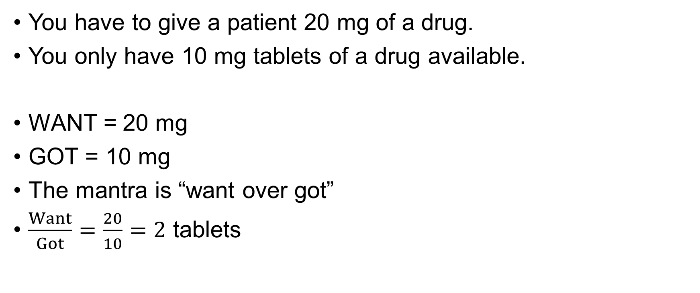
How would you do this?
You have to give a patient 20 mg of a drug.
You only have 10 mg tablets of a drug available.
WANT = 20 mg
GOT = 10 mg
The mantra is “want over got”
$\frac{Want}{Got}=\frac{20}{10}=2$ tablets

Slide 3
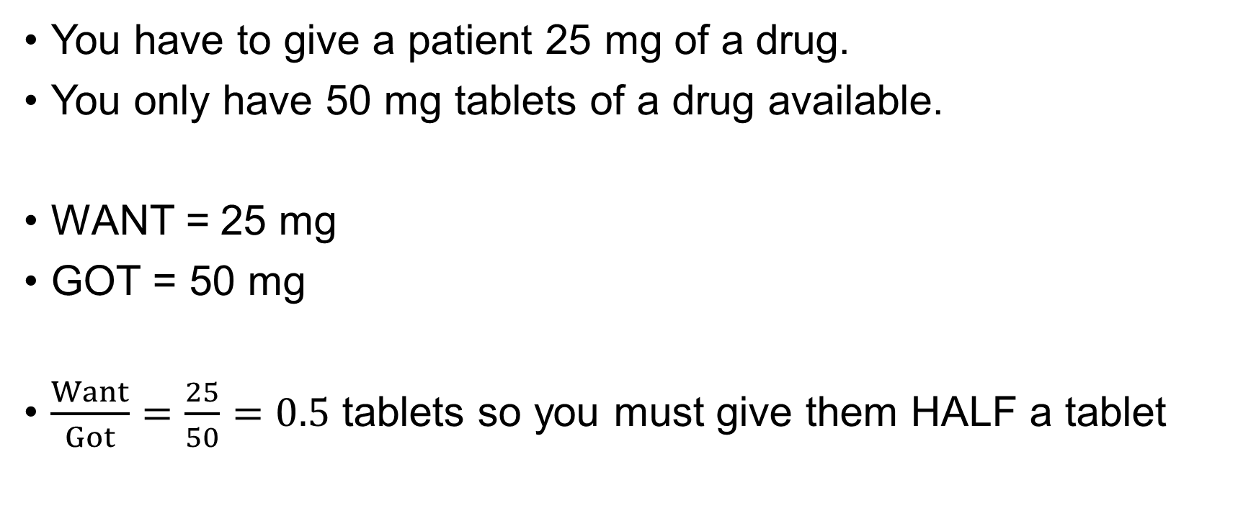
How would you do this?
You have to give a patient 25 mg of a drug.
You only have 50 mg tablets of a drug available.
WANT = 25 mg
GOT = 50 mg
$\frac{Want}{Got}=\frac{25}{50}=0.5$ tablets so you must give them HALF a tablet

Slide 4
What approach would you take here?
You have to give a patient 30 mg of a drug. You only have available 10 mg tablets and 20 mg tablets
OBSERVE: This is exactly the same question as giving 30 cents of change – you only have available 20 cent coins or 10 cent coins, nothing else
Both questions: “How do I make 30 from a collection of 10s and 20s?”

Slide 5
Two options exist:
Change
Tablets
Could give three 10 cent coins
Could give a 10 cent coin and a 20 cent coin
Which option is better?
Could give three 10 mg tablets
Could give a 10 mg tablet and a 20 mg tablet

Slide 6
And the winner is ….
Most people like to be given as few coins as possible to reduce the chances of dropping one, so you’d probably go with a 20 cent coin and a 10 cent coin
Most people would rather swallow two tablets than three, so a 20 mg tablet and a 10 mg tablet is a better choice

