Slide 1

Session One

Slide 2
Karakia Timatanga
Whakataka te hau ki te uru.
Whakataka te hau ki te tonga.
Kia mākinakina ki uta.
Kia mātaratara ki tai.
E hī ake ana te atakura.
He tio, he huka, he hau hū.
Tihei mauriora!
Cease the winds from the west.
Cease the winds from the south.
Let the breeze blow over the land.
Let the breeze blow over the ocean.
Let the red-tipped dawn come with a sharpened air.
A touch of frost, a promise of glorious day.

Slide 3

Waiata
Tō tatou waka
Ko te rangimārie
Ngā hoe o runga
Ko te puna o te aroha
Ko te puna o te aroha
Our vehicle of
peace paddles upon
the wellspring of love
the wellspring of love

Slide 4

Day plan
What’s happening today?

Slide 5
Cultural Share
FAMILY
INTERESTS
HERTIAGE
CAREER

Slide 6

Learning outcomes
By the end of the session you will be able to:
  Prepare your cultural share for future delivery.
  Prepare the ground rules around the management of the classroom and class discussions.
  Describe the key characteristics of adult learners.
  Differentiate between pedagogy and andragogy.

Slide 7

Setting up ground rules
Ground rules promote an environment of inclusion and respect for all. They articulate a set of expected behaviour for classroom conduct. These can be set up by the teacher or created by the learners themselves. It is believed that learners are more likely to adhere to ground rules if they played a role in creating them.

Slide 8

Setting up expectations
On separate Post-it notes write:
  Your expectations of your trainer.
  What the trainer should expect from you.
Place your post-its on the chart.
Look at all the comments.
Can you decide on a consensus (agreement)?

Slide 9
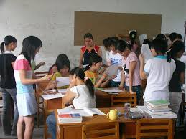
Ground rules for class discussion
Think about the best group discussion you have experienced.
  What made these experiences good?
  Write three things you could do to ensure that these things happen in your classroom.
  Discuss as a whole class
  Can you agree on a set of rules for this class?

Slide 10
Similarities and differences
From your experiences so far:
What do you think some of the differences between China and New Zealand’s teaching and learning environments might be?
What are some of the similarities?
Education in NZ
Education in China

Slide 11
Characteristics of adult learners
Think, Pair, Share:
  What makes an adult learner?
  How are they different from younger learners?
  What is the difference between ‘andragogy’ and ‘pedagogy’?
Think
Pair
Share

Slide 12
Pedagogy defined
… ‘to lead the child’
… the study of being a teacher
… the process of teaching
… the context of instruction
“a teacher dominated learning situation”
(Reece & Walker, 2007)

Slide 13
Andragogy defined
… the art and science of helping adults learn (Knowles, 1970)
… organised and sustained effort to assist adults to learn in a way that enhances their capability to function as self-directed learners
(Mezirow, 1981)
Notes:
Therefore: teaching and learning is a fundamentally different process with adults than it is with children

Slide 14
Characteristics of adult learners
the need to know …
learner self-concept …
role of learners' experience …
readiness to learn …
orientation to learning … (Knowles, 1970)
Notes:
The need to know — adult learners need to know why they need to learn something before undertaking to learn it
Learner self-concept —adults need to be responsible for their own decisions and to be treated as capable of self-direction
Role of learners' experience —adult learners have a variety of experiences which represent a rich resource for learning
Readiness to learn —adults are ready to learn those things they need to know in order to cope effectively with life situations
Orientation to learning —adults are motivated to learn when they see an immediate application for problem-solving

Slide 15
Implications
Explain the rationale for an area of content
Provide a safe learning environment
Encourage and support learners to:
  work collaboratively
  mutual planning (learners and facilitators/tutors)
  determine their own learning needs
Notes:
Explain the rationale for an area of content in order to satisfy adults’ need to know why they are learning something.
The adult learning environment should be physically and psychologically comfortable.
Learners should be supported in working collaboratively with others.
Encourage mutual planning between learners and with tutors.
Enable learners to determine their own learning needs.

Slide 16
More implications
Encourage and support learners to:
  design their learning outcomes
  design their own learning plans
  to evaluate their own learning
Foster critical reflection
Notes:
Help learners to design their learning outcomes.
Encourage learners to design their own learning plans.
Support learners to evaluate their own learning.
Foster critical reflection.

Slide 17
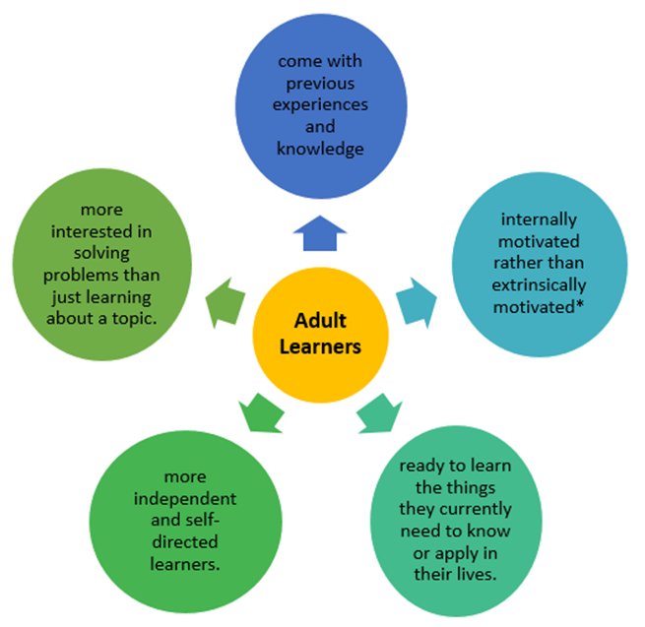
Five key assumptions

Slide 18

Five assumptions of andragogy
In pairs:
  Brainstorm ideas about how you can incorporate each assumption in your own teaching.
  Use Template C: Knowles’ Five Assumptions to record your ideas.
  Share your ideas in a whole class discussion.

Slide 19
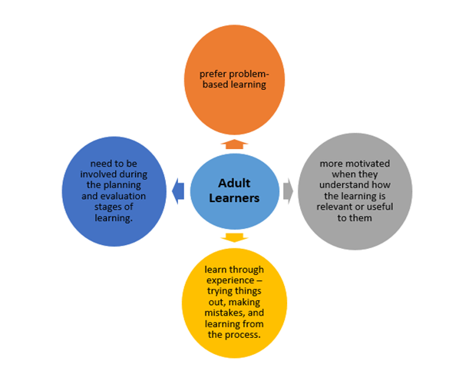
Four principles of andragogy

Slide 20
Four principles of andragogy
Brainstorm ideas about how you can incorporate each of theses principles in your own teaching.
Use Template D: Four Principles of Andragogy to record their ideas.
In groups share your ideas and then choose your best one or two idea(s) for each principle.
Share as a whole class

Slide 21
Review of learning outcomes
  Ensure you know when you are to share your cultural share.
  Given me the points that will be used to prepare the ground rules.
  Share with your neighbour one key characteristics of adult learners that you have not considered until today.
  Work on the meaning of these two words - pedagogy and andragogy.

Slide 22

Review
On a Post-it note write...​
What did you like? What could have been done better?​
What questions do you still have?

Slide 23
Karakia Whakamutanga
Unuhia, unuhia
Unuhia ki te uru tapu nui
Kia wātea, kia māmā, te ngākau, te tinana
Te wairua i te ara takatā
Koia rā e Rongo, whakairia ake ki runga
Kia tina! TINA! Hui e! TĀIKI E!
Draw on, draw on,
Draw on the supreme sacredness
To clear, to free the heart, the body and the spirit of mankind
Rongo, suspended high above us (“heaven”)
Draw together! Affirm!

