Slide 1
Welcome
Active Learning

Slide 2
Karakia Timatanga
Whakataka te hau ki te uru. Whakataka te hau ki te tonga. Kia mākinakina ki uta. Kia mātaratara ki tai. E hī ake ana te atakura. He tio, he huka, he hau hū. Tihei mauriora! | Cease the winds from the west. Cease the winds from the south. Let the breeze blow over the land. Let the breeze blow over the ocean. Let the red-tipped dawn come with a sharpened air. A touch of frost, a promise of glorious day.

Slide 3
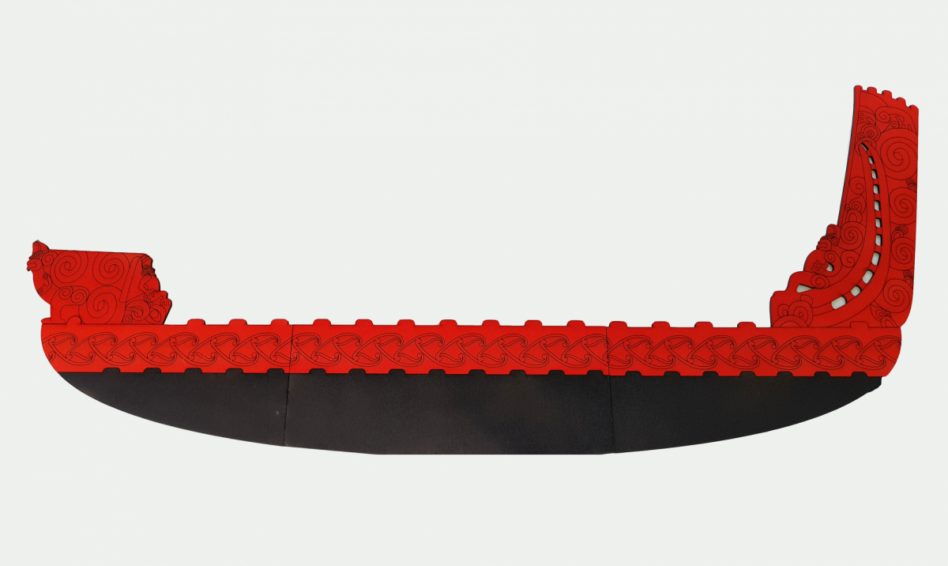

Waiata
Tō tatou waka Ko te rangimārie Ngā hoe o runga Ko te puna o te aroha Ko te puna o te aroha | Our vehicle of peace paddles upon the wellspring of love the wellspring of love

Slide 4
Learning outcomes
Discuss the benefits and challenges of active learning.
Describe, evaluate and select appropriate active learning techniques for your teaching context.
Design active learning activities for your module.

Slide 5
Define Active Learning p. 178
Read the definition and characteristics of active learning.
In pairs write a short (two-three sentence) definition of active learning that captures the key characteristics.

Slide 6
Active Particpation
Skill development – psychomotor
Higher-order thinking - cognitive
Self-development through reflection - affective

Slide 7
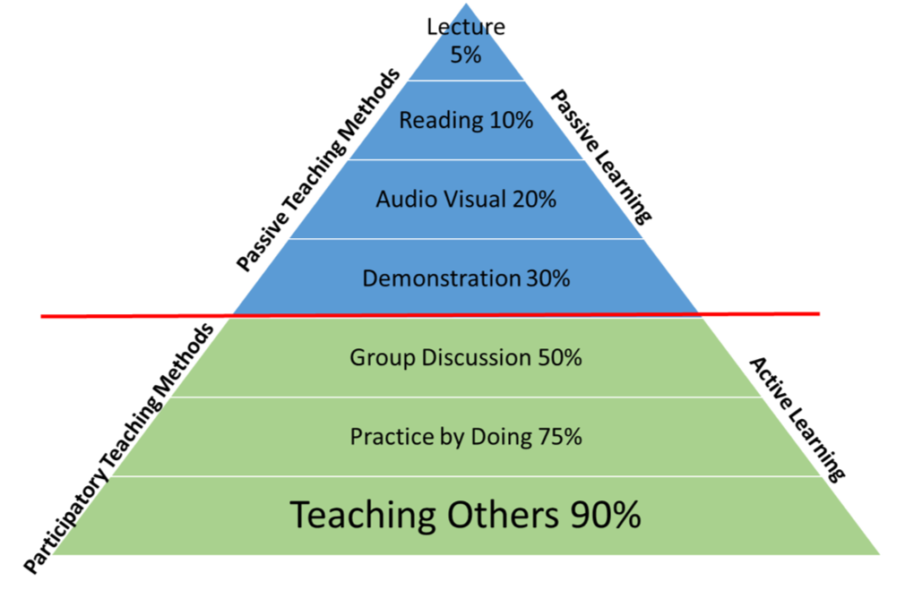
The Learning Pyramid

Slide 8
Benefits and Challenges. P. 180
Record
Individually record all the benefits of active learning you can think of. Write one idea per post-it note.
Repeat
Repeat for the challenges of active learning. This time using a different colour post-it note.
Share
Share your ideas with a small group and identify your group’s top four benefits and challenges.
Discuss and record
As a group discuss and record ways to manage or minimise the challenges of active learning.

Slide 9
Select Activities for Your Module p.181-182
Choose
Choose one session within your module to develop.
Identify
Identify the learning outcomes for the session.
Research
Research active learning strategies using the resource provided.
Select
Select two or three active learning strategies appropriate for your context.
Write
Write a description of the activity for your OSTAR style planning. This should include the strategy and the context it will be used in.
Share
Share your ideas in pairs – one you liked, and one suggestion

Slide 10
Strategies for Creating Groups.
P. 185
Your job is to find the person who has the matching heading or description to your piece of paper. There are 7 headings and 7 descriptions.
Once you have matched the heading and description, share yours with the larger group

Slide 11

Feedback
Please share:
One thing you enjoyed about this week?
One thing that could be improved?
Two things you learnt?

Slide 12
Karakia Whakamutanga
Unuhia, unuhia Unuhia ki te uru tapu nui Kia wātea, kia māmā, te ngākau, te tinana Te wairua i te ara takatā Koia rā e Rongo, whakairia ake ki runga Kia tina! TINA! Hui e! TĀIKI E! | Draw on, draw on, Draw on the supreme sacredness To clear, to free the heart, the body and the spirit of mankind Rongo, suspended high above us (“heaven”) Draw together! Affirm!

