Slide 1
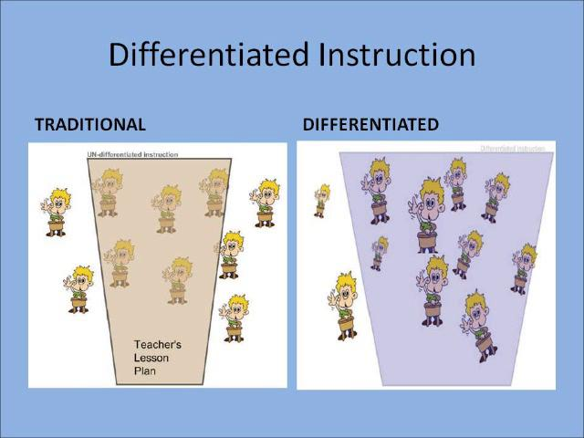
Session Ten
Creating a learner-centred environment using differentiated instruction
This Photo by Unknown Author is licensed under CC BY-NC-ND

Slide 2
Karakia Timatanga
Whakataka te hau ki te uru.
Whakataka te hau ki te tonga.
Kia mākinakina ki uta.
Kia mātaratara ki tai.
E hī ake ana te atakura.
He tio, he huka, he hau hū.
Tihei mauriora!
Cease the winds from the west.
Cease the winds from the south.
Let the breeze blow over the land.
Let the breeze blow over the ocean.
Let the red-tipped dawn come with a sharpened air.
A touch of frost, a promise of glorious day.

Slide 3

Waiata
Tō tatou waka
Ko te rangimārie
Ngā hoe o runga
Ko te puna o te aroha
Ko te puna o te aroha
Our vehicle of
peace paddles upon
the wellspring of love
the wellspring of love

Slide 4

Day plan
What’s happening today?

Slide 5
Cultural Share
FAMILY
INTERESTS
HERTIAGE
CAREER

Slide 6

Learning outcomes
List different learning styles.
Evaluate teaching methods by their capacity to differentiate.
Identify methods you could use to differentiate well.
Consider the possible challenges associated with moving towards a learner-centred learning environment with possible solutions.
Notes:
List the pros and cons of differentiated instruction linked to your teaching and learning context.
Consider the possible challenges associated with moving towards a learner-centred learning environment with possible solutions.

Slide 7
Differentiate
Can accommodate differences between students due to their different ability, prior learning, motivation and learning style.

Slide 8
Teaching Methods
Your task is to place each method card in one of the following categories assuming the teaching method is used by itself:
A. Can differentiate well
B. Can differentiate reasonably well
C. Does not differentiate well

Slide 9
Differentiated instruction is …..
Teaching the same material in a variety of ways, dependent on the abilities of the learner
How might this be done …..
Notes:
same material to all students using a variety of instructional strategies, or it may require the teacher to deliver lessons at varying levels of difficulty based on the ability of each student.
How might this be done …….
*Design lessons based on students’ learning styles.
*Group students by shared interest, topic, or ability for assignments.
*Assess students’ learning using formative assessment.
*Manage the classroom to create a safe and supportive environment.
*Continually assess and adjust lesson content to meet students’ needs.

Slide 10
Four ways to differentiate instruction
Learning Environment
Product
Content
Process

Slide 11
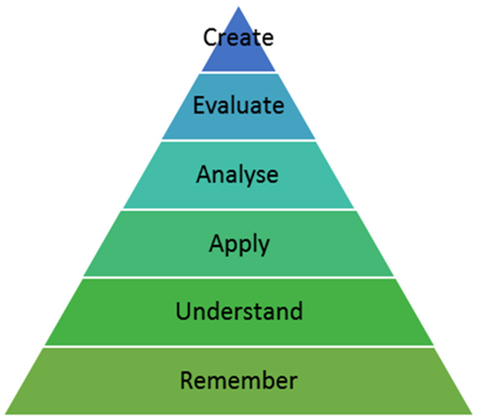
Content
Design activities for groups of learners that cover various levels of Bloom’s Taxonomy
Notes:
In the resource book the following statements are aligned with Figure 3: Bloom's Taxonomy - Cognitive Domain
Students who are unfamiliar with a lesson could be required to complete tasks on the lower levels: remembering and understanding. While students with some mastery could be asked to apply and analyse the content, and
Those students who have high levels of mastery could be asked to complete tasks in the areas of evaluating and creating.

Slide 12
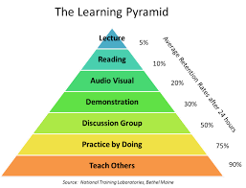
Process
successful differentiation includes delivering the material to each style: visual, auditory and kinaesthetic, and through words
Notes:
In the resource book the following statements are aligned with Figure 3: Bloom's Taxonomy - Cognitive Domain
Provide textbooks or case study readings to read/write learners.
Provide videos or animations to watch and discuss to visual learners.
Allow auditory learners to listen to audio books or podcasts.
Give kinaesthetic learners the opportunity to complete an interactive assignment online or involve them in a discussion on an online forum.

Slide 13

Product
what the student creates that demonstrates mastery
Notes:
In the resource book the following statements are aligned with Figure 3: Bloom's Taxonomy - Cognitive Domain
Visual learners create a graphic organizer or a concept map to build a model.
Kinaesthetic learners build the model using Computer Aided Design (CAD) software and then brainstorm with the team members to build the model with recycled materials
Auditory learners write the report or give an oral report.

Slide 14
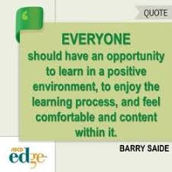
Learning environment
optimal learning include both physical and psychological elements
Notes:
In the resource book the following statements are aligned with Figure 3: Bloom's Taxonomy - Cognitive Domain
Break some students into reading groups to discuss the assignment.
Allow students to read individually if preferred.
Create quiet spaces where there are no distractions.

Slide 15
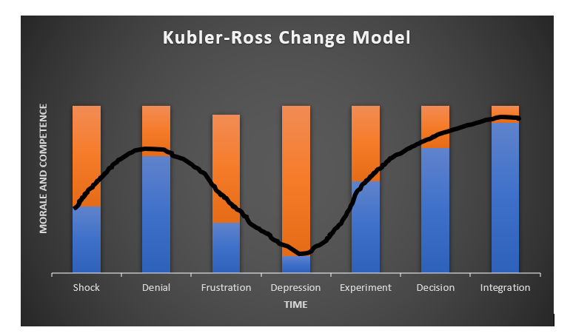
Transitioning …….
Notes:
Shock – or surprise at the event
Denial – looking for evidence that it isn’t true
Frustration – sometimes anger, recognition that things are different
Depression – low mood, lacking in energy
Experiment – initial engagement with the new situation

Slide 16
Recap
One pro and one con of using differentiated instruction in your teaching context.
One challenge and one possible solution for change in your teaching context.

Slide 17
Karakia Whakamutanga
Unuhia, unuhia
Unuhia ki te uru tapu nui
Kia wātea, kia māmā, te ngākau, te tinana
Te wairua i te ara takatā
Koia rā e Rongo, whakairia ake ki runga
Kia tina! TINA! Hui e! TĀIKI E!
Draw on, draw on,
Draw on the supreme sacredness
To clear, to free the heart, the body and the spirit of mankind
Rongo, suspended high above us (“heaven”)
Draw together! Affirm!

