Slide 1
Module Two
Session 1
Current Knowledge

Slide 2
Karakia Timatanga
Whakataka te hau ki te uru.
Whakataka te hau ki te tonga.
Kia mākinakina ki uta.
Kia mātaratara ki tai.
E hī ake ana te atakura.
He tio, he huka, he hau hū.
Tihei mauriora!
Cease the winds from the west.
Cease the winds from the south.
Let the breeze blow over the land.
Let the breeze blow over the ocean.
Let the red-tipped dawn come with a sharpened air.
A touch of frost, a promise of glorious day.

Slide 3

Waiata
Tō tatou waka
Ko te rangimārie
Ngā hoe o runga
Ko te puna o te aroha
Ko te puna o te aroha
Our vehicle of
peace paddles upon
the wellspring of love
the wellspring of love

Slide 4

Day plan
What’s happening today?

Slide 5

Session outcomes
Shared your experience of assessment
Why we assess learning
Your assessment philosophy
Ways of assessing

Slide 6
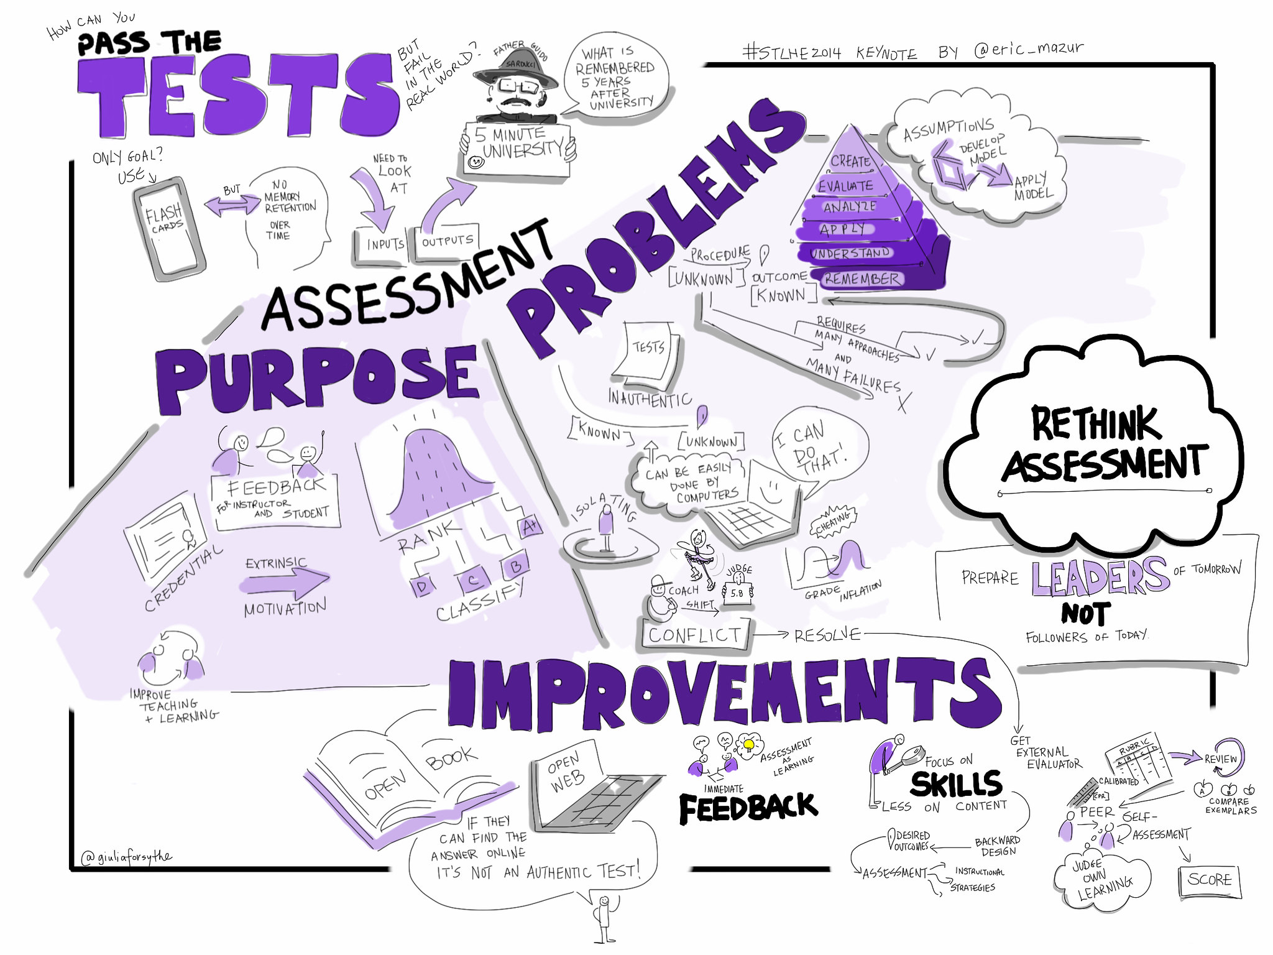

Slide 7
Share with neighbour the hardest thing about writing an assessment task.
Share with neighbour one negative and one positive of undertaking an assessment.
Notes:
Two distinct tasks here:
1. All those who have written an assessment stand one side of the room – share with neighbor the hardest thing about writing the assessment – snowball to another pair – decide on the one point to share with group.
2. Other side of room choose a partner and give one negative and one positive of undertaking an assessment. Move to another pair, share and come up with one combined positive and negative

Slide 8
Why do we assess learning?
Our institutions require us to!
Learners want to know how they doing?
To check whether learning has happened.

Slide 9
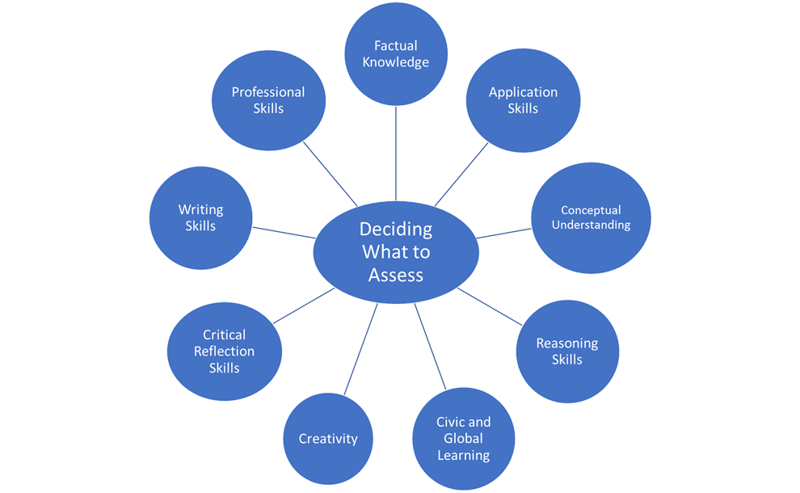
What do we assess?

Slide 10
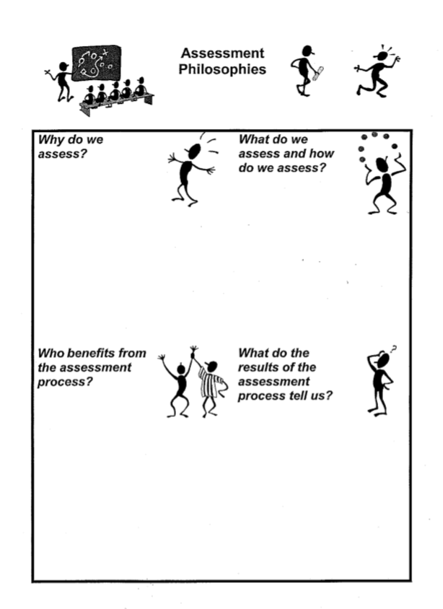
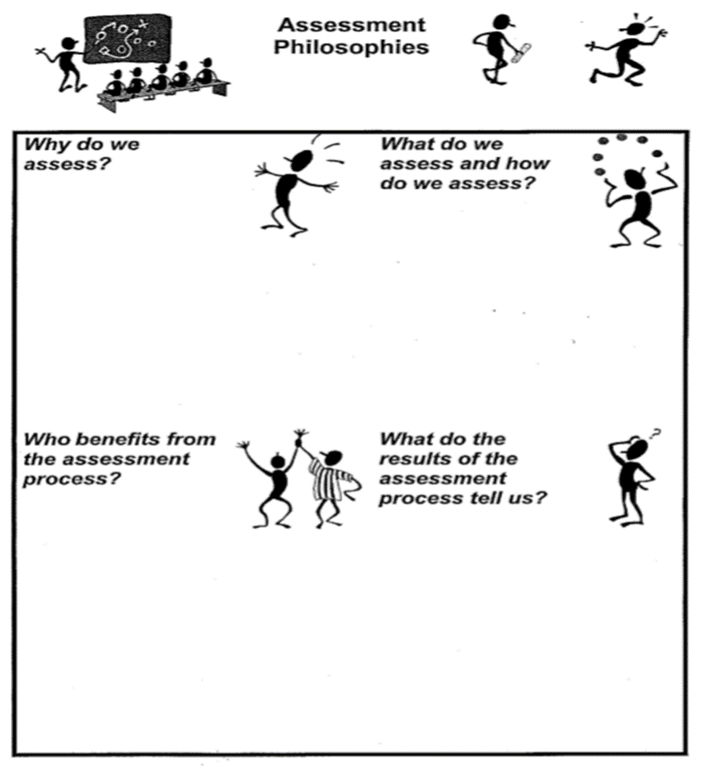
Assessment Philosophy

Slide 11
No summative assessment should be greater than 25%
All teaching staff should be learners
All managers/HoDs should have to spend time teaching and assessing
Marks should not be allowed to be given to learners
Learners should have to self-assess their work before handing it in
Notes:
Phil Race thoughts on assessment

Slide 12
Session outcomes
…. shared your experience of assessment
….why we assess learning
…..your assessment philosophy
…..ways of assessing

Slide 13
Karakia Whakamutanga
Unuhia, unuhia
Unuhia ki te uru tapu nui
Kia wātea, kia māmā, te ngākau, te tinana
Te wairua i te ara takatā
Koia rā e Rongo, whakairia ake ki runga
Kia tina! TINA! Hui e! TĀIKI E!
Draw on, draw on,
Draw on the supreme sacredness
To clear, to free the heart, the body and the spirit of mankind
Rongo, suspended high above us (“heaven”)
Draw together! Affirm!

