Slide 1
Module Two
Session 2
Perspectives

Slide 2
Karakia Timatanga
Whakataka te hau ki te uru.
Whakataka te hau ki te tonga.
Kia mākinakina ki uta.
Kia mātaratara ki tai.
E hī ake ana te atakura.
He tio, he huka, he hau hū.
Tihei mauriora!
Cease the winds from the west.
Cease the winds from the south.
Let the breeze blow over the land.
Let the breeze blow over the ocean.
Let the red-tipped dawn come with a sharpened air.
A touch of frost, a promise of glorious day.

Slide 3

Waiata
Tō tatou waka
Ko te rangimārie
Ngā hoe o runga
Ko te puna o te aroha
Ko te puna o te aroha
Our vehicle of
peace paddles upon
the wellspring of love
the wellspring of love

Slide 4

Day plan
What’s happening today?

Slide 5
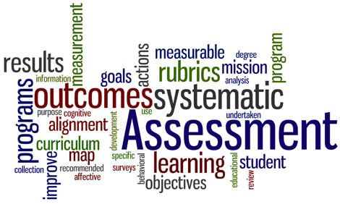
Session outcomes
Role of the facilitator in assessment of/for/as learning
Participated in an assessment activity
Identified and analysed basic principles of sound assessment
Notes:
reviewed the role of the facilitator in assessment of/for/as learning

Slide 6
Why is Assessment so Critical …
“… assessment is the engine which drives student learning …”
“… assessment and feedback are strongly linked to student retention...”
“Assessment and associated feedback are key factors impacting on student motivation and commitment.”
Race, P. (2007). Making teaching work. London: Sage Publications.
Notes:
Links to heading in resource book – leads to discussion on types of assessment tasks frequently used Activity 5 is optional around the types of careers/professionals learners will undertake and whether the current assessment tasks used mirror real-life.

Slide 7
Ways of Assessing
Current ways you assess | New ideas you might consider
Notes:
Activity 6 – complete to get idea of current methodologies and direct learners to ‘Sample Assessment Methods’ in resource book for more ideas.
Follow with Activity 7 as required

Slide 8
Perspectives on Assessment
Assessment of learning
Assessment for learning
Assessment as learning
Notes:
three different perspectives on assessment to illustrate the implications of educational developments for assessment practice:
assessment of learning – focus on summative results:
assessment for learning - delivers feedback to help learners self-correct
assessment as learning - encourages students to be actively involved in their own learning and assessment. Assessment is not done to the learner, assessment is negotiated with the learner.
Encourage and assist learners to be able to assess themselves and their learning.
Assessment as learning provides learners with choices about what they need to learn and how they can provide evidence of that learning. It is about providing learners with challenging tasks that encourage interaction and dialogue.

Slide 9
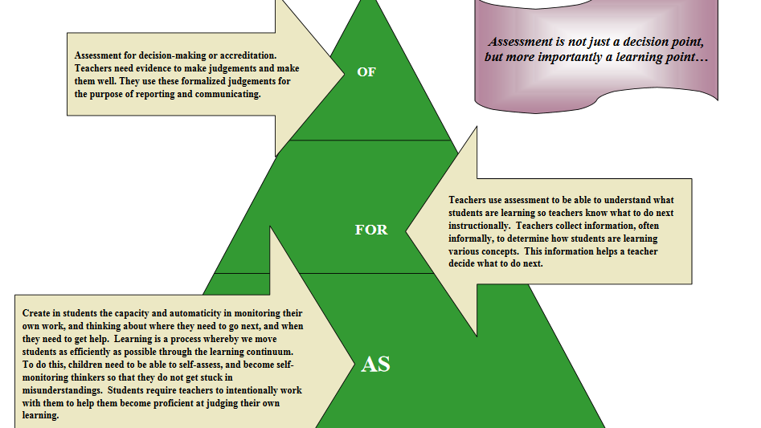

Slide 10

Read the instructions on the handout and be ready in 20 mins to fly your plan.

Slide 11
Team
Flight
Creativity
Design
Pilot
Total

Slide 12
What was wrong with the assessment?
Notes:
Look for unfairness (not equitable), lack of marking criteria, bias of marker, changing the rules, validity – were the skills and knowledge being tested appropriate to the content of the course, paper, programme? Leads onto Activity 9: Principles which uses Phil Race’s thoughts.

Slide 13
Principles of Sound Assessment according to Phil Race…..
Validity Fairness
‘whodunit’ Transparency
Real wold dimensions
Notes:
Complete activity 9 to define:

Slide 14
Principles of sound assessment
C
R
A
V
E
S
Consistent
Reliable
Authentic
Valid
Equitable - fair
Sufficient
Notes:
Activity 9: Principles of Sound Assessment - Race suggests Validity, fairness, whodunit, transparency, real world. We can links this to CRAVES
Consistent: Given similar circumstances the assessor would make the same judgement again and the judgement will be similar to judgements that other assessors would make
Reliable: different Assessors can use it and get the same results.
Authentic: The assessor will be confident that the work being assessed is attributable to the person being assessed – outside assistance must not distort the assessment.
Valid: Assessment will be fit for purpose, so that assessment focuses on the requirements specified in unit standards.
Equitable: The methods used will be straightforward, readily arranged and will not interfere unduly with learning./manageable and fair.
Sufficient: The evidence will establish with confidence that all criteria have been met and that performance to the required standard could be repeated with consistency.
Race’s real-life relates to making sure the assessment task is authentic ……

Slide 15
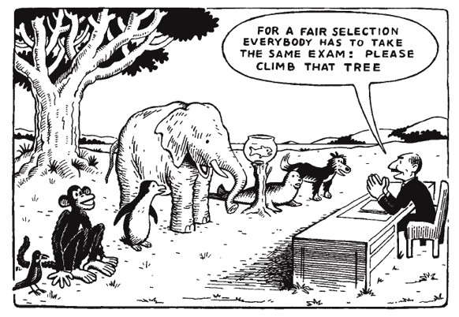
An example of a good assessment?
Notes:
Share with neighbour which principles of sound principles this cartoon illustrates

Slide 16
Points to ponder …
What is the role of the facilitator when assessing learning …..
Is it to gather results ?
Is it to give feedback to aid learning?
Or is it a means of encouraging learners to be active in their own learning?
of learning
for learning
as learning
Notes:
assessment of learning – focus on summative results:
assessment for learning - delivers feedback to help learners self-correct
assessment as learning - encourages students to be actively involved in their own learning and assessment. Assessment is not done to the learner, assessment is negotiated with the learner.
Encourage and assist learners to be able to assess themselves and their learning.
Assessment as learning provides learners with choices about what they need to learn and how they can provide evidence of that learning. It is about providing learners with challenging tasks that encourage interaction and dialogue.

Slide 17
Review
Feedback round:
Share with your neighbour one new piece of learning around assessment that you have gained today.
Using a post-it note record any unanswered questions you still have.
Notes:
role of the facilitator in assessment of/for/as learning
.....participated in an assessment activity
….identified and analysed basic principles of sound assessment

Slide 18
Karakia Whakamutanga
Unuhia, unuhia
Unuhia ki te uru tapu nui
Kia wātea, kia māmā, te ngākau, te tinana
Te wairua i te ara takatā
Koia rā e Rongo, whakairia ake ki runga
Kia tina! TINA! Hui e! TĀIKI E!
Draw on, draw on,
Draw on the supreme sacredness
To clear, to free the heart, the body and the spirit of mankind
Rongo, suspended high above us (“heaven”)
Draw together! Affirm!

