Slide 1
Module Two
Session 4
Constructive Alignment

Slide 2
Karakia Timatanga
Whakataka te hau ki te uru.
Whakataka te hau ki te tonga.
Kia mākinakina ki uta.
Kia mātaratara ki tai.
E hī ake ana te atakura.
He tio, he huka, he hau hū.
Tihei mauriora!
Cease the winds from the west.
Cease the winds from the south.
Let the breeze blow over the land.
Let the breeze blow over the ocean.
Let the red-tipped dawn come with a sharpened air.
A touch of frost, a promise of glorious day.

Slide 3

Waiata
Tō tatou waka
Ko te rangimārie
Ngā hoe o runga
Ko te puna o te aroha
Ko te puna o te aroha
Our vehicle of
peace paddles upon
the wellspring of love
the wellspring of love

Slide 4

Day plan
What’s happening today?

Slide 5
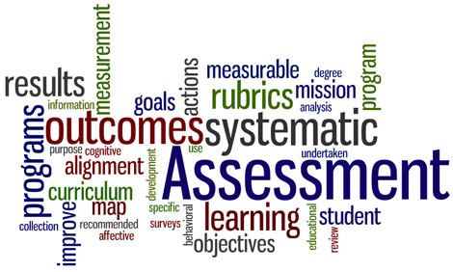
Session outcomes
Shared the reasons for constructive alignment of learning outcomes, learning activities and assessment.
Selected appropriate/possible assessment tasks that link to the learning outcomes of their own module of learning.

Slide 6
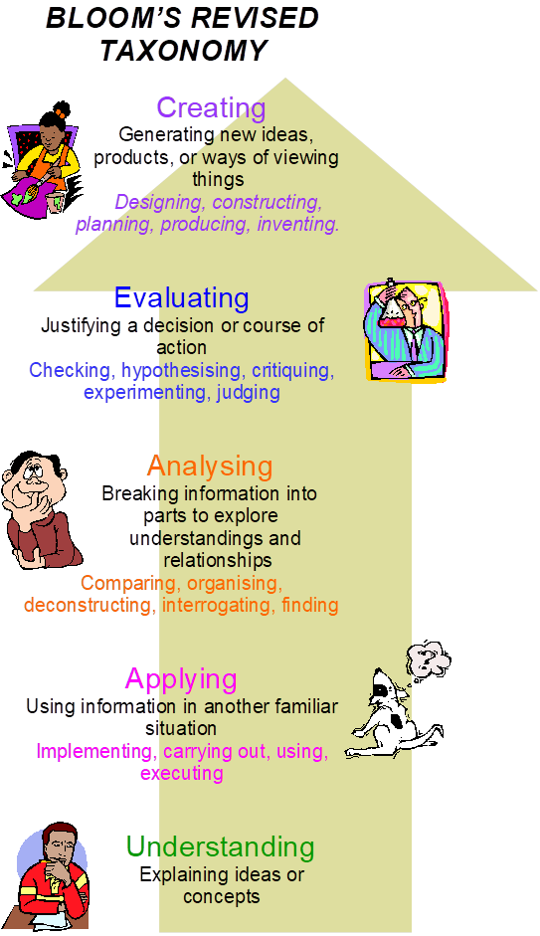
Levels of Learning revisited

Slide 7
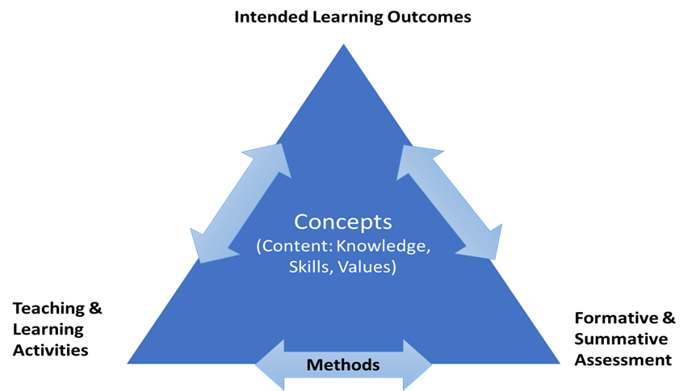
Constructive Alignment – Ellis, 2007
Notes:
Constructive alignment is actually extremely difficult to achieve: it is virtually impossible to get it right first time, through so-called rational top-down course design. Hence the importance of the reflective practitioner; the teacher who constantly modifies course design and delivery, constantly trying to work closer to the unattainable perfect constructive alignment. Moreover, this is not simply a matter of modifying learning activities and assessment. Sometimes, in the delivery of a module, assessment outcomes, or our work with students, reveal learning outcomes we had not anticipated but that we nevertheless recognise as valuable. These emergent learning outcomes need to be identified and incorporated into the intended learning outcomes. Constructive alignment cannot be achieved or maintained in an institutional system that does not allow frequent modification of module descriptions

Slide 8
Constructive Alignment - Biggs, 1999
Learning and teaching activities designed to meet learning outcomes
Intended Learning Outcomes
Assessment methods designed to assess learning outcome
Notes:
John Biggs was a leading authority on the idea of constructive alignment - Figure 1. There are two parts to constructive alignment:
Students construct meaning from what they do to learn.
The teacher aligns the planned learning activities with the learning outcomes.
The basic premise of the whole system is that the curriculum is designed so that the learning activities and assessment tasks are aligned with the learning outcomes that are intended in the course. [Ref: Aligning learning outcomes, learning and teaching activities and the assessment. Adapted from Biggs (1999)

Slide 9
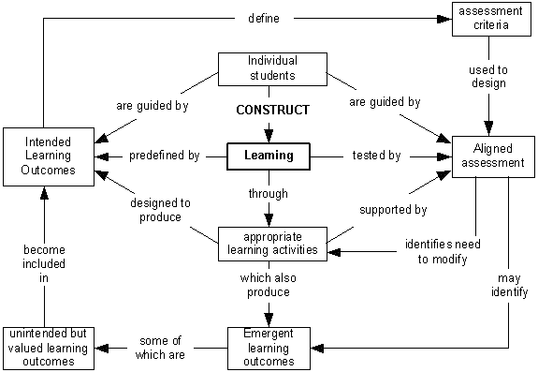
Notes:
Constructive alignment is actually extremely difficult to achieve: it is virtually impossible to get it right first time, through so-called rational top-down course design. Hence the importance of the reflective practitioner; the facilitator/teacher who constantly modifies course design and delivery, constantly trying to work closer to the unattainable perfect constructive alignment. Moreover, this is not simply a matter of modifying learning activities and assessment. Sometimes, in the delivery of a module, assessment outcomes, or our work with students, reveal learning outcomes we had not anticipated but that we nevertheless recognise as valuable. These emergent learning outcomes need to be identified and incorporated into the intended learning outcomes. Constructive alignment cannot be achieved or maintained in an institutional system that does not allow frequent modification of module descriptions

Slide 10
Structure
Formative Assessment
Assessment for learning
Providing feedback
Summative Assessment
Assessment of learning
Being fair, equitable as well as valid and reliable

Slide 11

Formative feedback
“Assessing learners work and giving them feedback would be much better for me if only I ….”
Notes:
Swap post-its until you don’t know whose you have
Read with feeling the post-it message
Stick on whiteboard
Problems – feedback into writing instead of face to face, student’s taking notice of feedback, and enough time to respond sufficiently.

Slide 12
It’s one way
Too late
Words on paper
It’s ignored
Problems with Feedback

Slide 13
Why do we do it?
Correct what is wrong
Give credit
Offer improvements
Notes:
Focus on achievements – avoiding the failings, cause that saps student’s confidence

Slide 14

How do you give feedback?
Think
Share
Notes:
Email
Word-processing tools used to compose individual feedback emails
Give feedback before the submit their work
Emphasis you will give feedback, so they expect it
Reduce the size of the work being marked
Separate mark from feedback comments – students decide mark based on your feedback
Use technology to give generic feedback
Use face to face context (whole class lectures) to give feedback and to check understanding (eg ‘The most important thing I don’t yet understand is …’)
Technology enhanced feedback – track changes, convenient as anytime/place, can edit before sending, they can receive it in private, can tailor to individuals, use electronic cut and paste, provides external review. BEWARE students can ‘lose’ emailed feedback.
Computer conferences – one-to-many electronic communication, saves time, respond to factors that affect many students, students can reply individually to you
Computer-deliver feedback – Moodle/web-based packages – instantaneous responses, usually repeat until correct – problem is ‘now you see it, now it’s gone’ can affect students’ retention of feedback messages.

Slide 15
Assessment has most effect when ….
It is used to engage students learning.
Feedback is used to actively improve learning.
Learners and facilitators are responsible partners in learning.
Assessment for learning is placed at the centre of programme/module design.

Slide 16
Continued ...
Assessment provides inclusive and trustworthy representation of learner achievement.
Learners are inducted into the assessment practices and cultures of higher education.
Assessment for learning is a focus for staff and institutional development.
Boud, D. and Associates. (2010). Assessment 2020: Seven propositions for assessment reform in higher education. Sydney: Learning and Teaching Council.

Slide 17
"Nothing that we do to, or for, our students is more important than our assessment of their work and the feedback we give them on it. The results of our assessment influence our students for the rest of their lives and careers – fine if we get it right, but unthinkable if we get it wrong."
Race, Brown and Smith (2005), 500 Tips on Assessment

Slide 18
Session outcomes revisited
Share with your neighbour what it means to constructively align learning outcomes, learning activities and assessment. Give a reason why it might be useful.
Shared with the group any issue(s) they have not considered before around feedback.

Slide 19
Life is too short to waste time on composing feedback that won’t be read or used.
(Race, 2005)

Slide 20

Muddiest point
​
What was the ‘muddiest’ point from today’s session?
Notes:
Ask learners to write down what they perceived as the muddiest point in a lecture, reading, etc. The muddiest point is something that they still do not fully understand, or are having difficulty with. Collect responses then clarify these muddy points during the next class.

Slide 21
Karakia Whakamutanga
Unuhia, unuhia
Unuhia ki te uru tapu nui
Kia wātea, kia māmā, te ngākau, te tinana
Te wairua i te ara takatā
Koia rā e Rongo, whakairia ake ki runga
Kia tina! TINA! Hui e! TĀIKI E!
Draw on, draw on,
Draw on the supreme sacredness
To clear, to free the heart, the body and the spirit of mankind
Rongo, suspended high above us (“heaven”)
Draw together! Affirm!

