Slide 1
Module Two
Session 8
Creating Innovative Assessment Tasks

Slide 2
Karakia Timatanga
Whakataka te hau ki te uru.
Whakataka te hau ki te tonga.
Kia mākinakina ki uta.
Kia mātaratara ki tai.
E hī ake ana te atakura.
He tio, he huka, he hau hū.
Tihei mauriora!
Cease the winds from the west.
Cease the winds from the south.
Let the breeze blow over the land.
Let the breeze blow over the ocean.
Let the red-tipped dawn come with a sharpened air.
A touch of frost, a promise of glorious day.

Slide 3

Waiata
Tō tatou waka
Ko te rangimārie
Ngā hoe o runga
Ko te puna o te aroha
Ko te puna o te aroha
Our vehicle of
peace paddles upon
the wellspring of love
the wellspring of love

Slide 4

This session is intended as practical workshop where you work on the design of your assessment items/task(s)

Slide 5
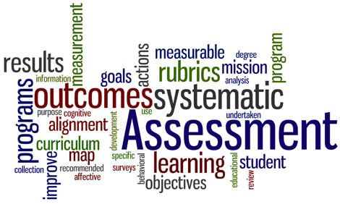
Session outcomes
Create a learner centred assessment task that incorporates principles of sound assessment.
Notes:
reviewed the role of the facilitator in assessment of/for/as learning

Slide 6
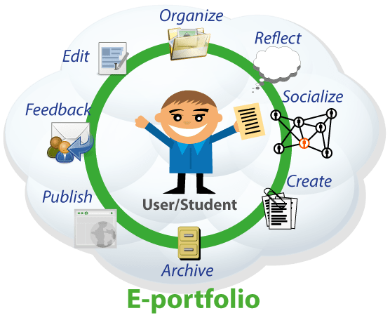

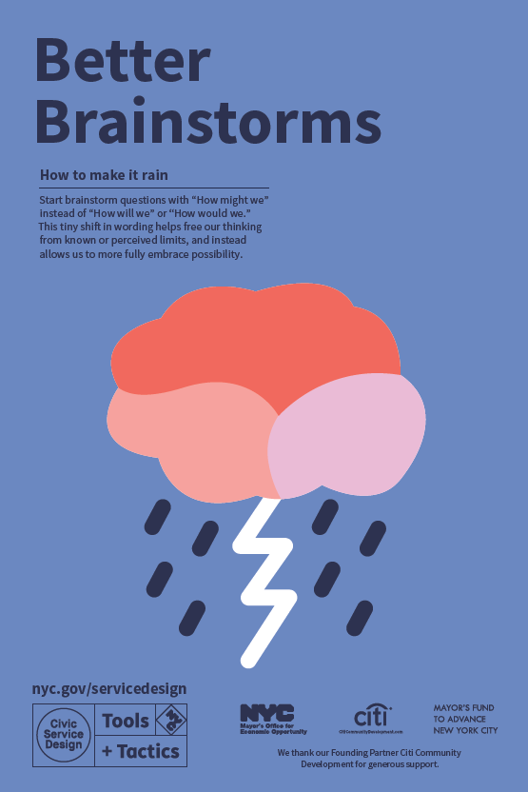

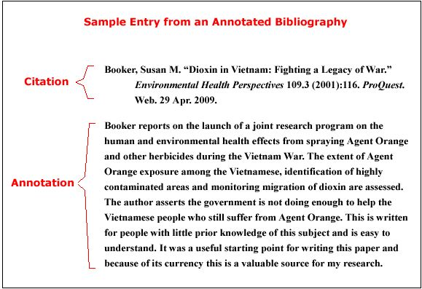
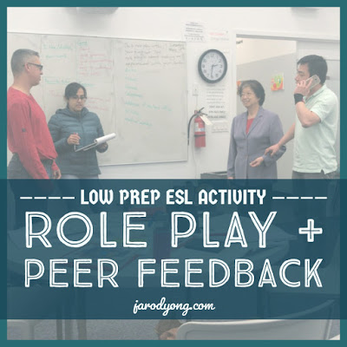
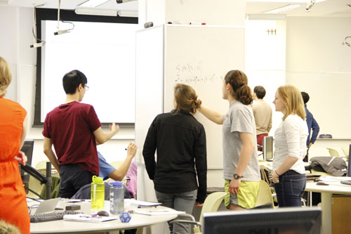
Alternatives ……
Notes:
Multiple drafts of written work, portfolios, including e-portfolios, oral presentations, peer evaluations, group assessments, service-learning involving community or business/industry, in-tray exercises, posters, annotated bibliographies, reflective commentaries, critical incident accounts, reviews, role-plays, case studies etc
The terms "role play" and "simulation" are sometimes used inconsistently or interchangeably. However, "simulations" often involve a familiar or realistic situation in which a participant’s role may not be as prominent or distinctive as it would be in a role play. Frequently simulations incorporate role play, leading to the term "role-playing simulation". The difference is generally one of degree
From UNSW - Role plays and simulations function as learning tools for teams and groups or individuals as they "play" online or face to face. They alter the power ratios in teaching and learning relationships between students and educators, as students learn through their explorations and the viewpoints of the character or personality they are articulating in the environment. This student-centered space can enable learner-oriented assessment, where the design of the task is created for active student learning. Students are actively involved in both self and peer assessment and obtain sustainable formative feedback. Video Series - Using Role Plays in Formative Assessment - Ben Barry & Gail Trapp. Assessed from https://teaching.unsw.edu.au/assessing-role-play-and-simulation.
All graphics from creative commons

Slide 7
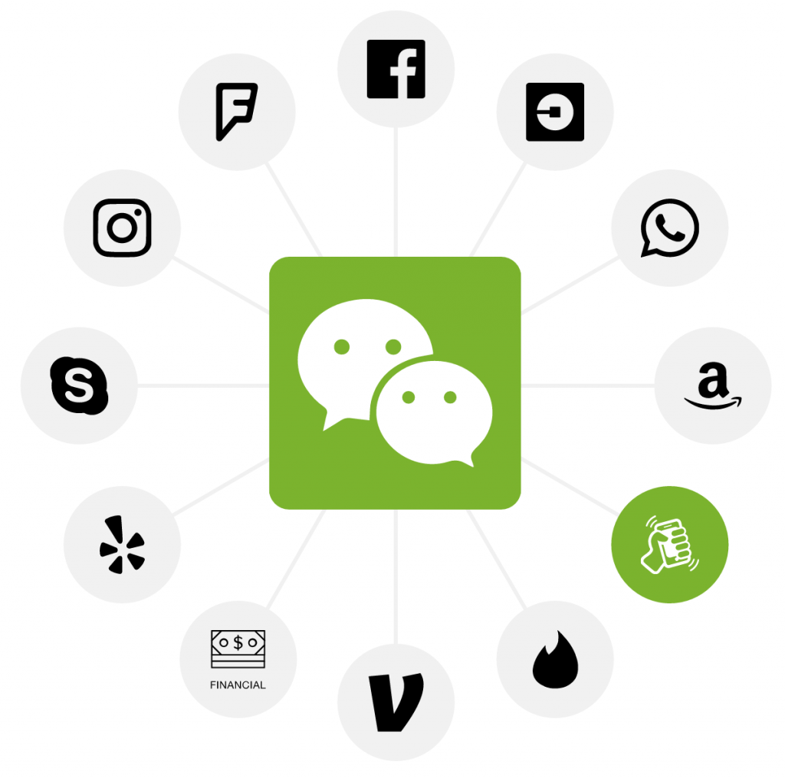
What 21st century tools might you incorporate?
Microsoft Sway​
Prezi​
PowerPoint​
Google Slides
Facebook
WeChat
Instant messaging
Online blogs etc
This Photo by Unknown Author is licensed under CC BY
Notes:
Refer back to Module One – add to this list ….

Slide 8
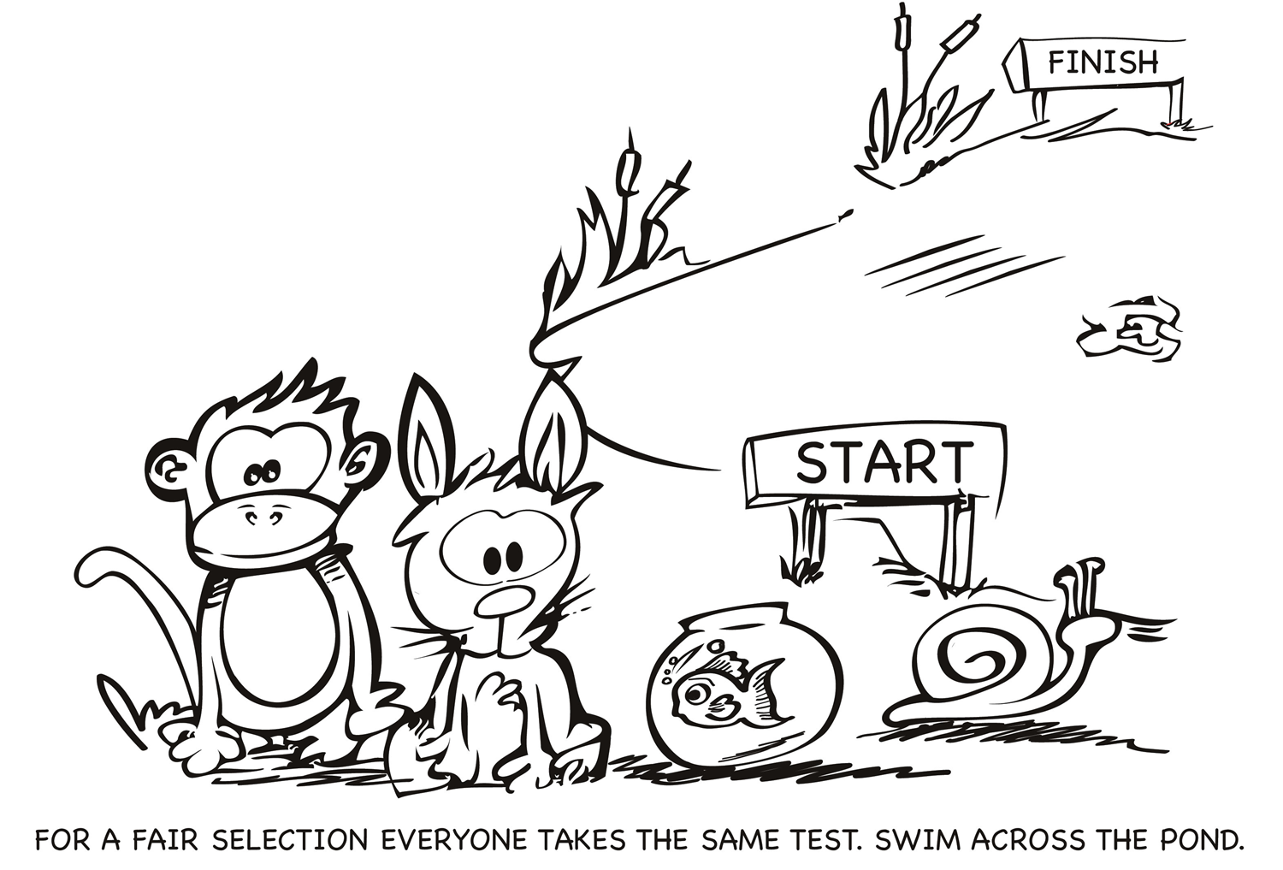

Slide 9
Rethinking Fairness
Equity and difference
Judging learners’ work in relation to their context
Internal fairness – not making allowances, or anything goes, it is assessment which suits the contexts learners come from and will go to

Slide 10
Internal fairness
Recognising context
Providing equal access to resources, materials and learning experiences
Negotiation with learners, on-going consultation and encouraging feedback
Moderation to ensure the assessment provides evidence of achieving learning outcomes

Slide 11
Ticket Out Of Class
Please spend the last five minutes responding to these two questions:
Has this workshop assisted you with your project? If so, how?
___________________________________________________________________________________________________________________________________________________________________________________________________________________________________________
Is the timing of this workshop suitable? If not, earlier or later in the programme of study?
__________________________________________________________________________________________________________________________________________________________________________________________________________________________________________________________________________________________
Thank You
Notes:
Use the ticket out of class – printed off

Slide 12
Karakia Whakamutanga
Unuhia, unuhia
Unuhia ki te uru tapu nui
Kia wātea, kia māmā, te ngākau, te tinana
Te wairua i te ara takatā
Koia rā e Rongo, whakairia ake ki runga
Kia tina! TINA! Hui e! TĀIKI E!
Draw on, draw on,
Draw on the supreme sacredness
To clear, to free the heart, the body and the spirit of mankind
Rongo, suspended high above us (“heaven”)
Draw together! Affirm!

