Slide 1
Module Two
Session Ten
Moderation
This Photo by Unknown Author is licensed under CC BY-NC-ND

Slide 2
Karakia Timatanga
Whakataka te hau ki te uru.
Whakataka te hau ki te tonga.
Kia mākinakina ki uta.
Kia mātaratara ki tai.
E hī ake ana te atakura.
He tio, he huka, he hau hū.
Tihei mauriora!
Cease the winds from the west.
Cease the winds from the south.
Let the breeze blow over the land.
Let the breeze blow over the ocean.
Let the red-tipped dawn come with a sharpened air.
A touch of frost, a promise of glorious day.

Slide 3

Waiata
Tō tatou waka
Ko te rangimārie
Ngā hoe o runga
Ko te puna o te aroha
Ko te puna o te aroha
Our vehicle of
peace paddles upon
the wellspring of love
the wellspring of love

Slide 4

Day plan
What’s happening today?

Slide 5
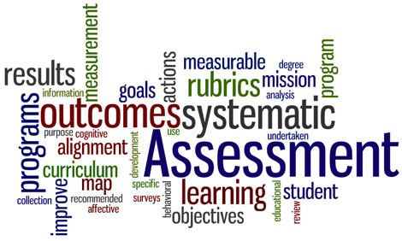
Session outcomes
Described the process of moderation.
Discussed the importance of moderation.
Applied best practice moderation principles.

Slide 6
Introduction
Moderation
What
Why
Where
Who
When

Slide 7

Moderation
WHAT
Is a process to make sure that assessments are valid, fair, and consistent.
……type of quality assurance to make sure assessors' judgements are consistent across the country/institutions and across different standards.
……international best practice!

Slide 8
Moderation
WHY
  Alignment of assessment to learning
  Quality of assessment tool(s)
  Adherence to academic standards
Notes:
curriculum is properly and adequately covered
assessment activities are fair and reasonable for the learner for whom the assessment is intended
questions/instructions are clearly and unambiguously worded
assessment activities can be satisfactorily completed in the time allowed
technical aspects are of a professional standard (layout, spelling, grammar, etc.)
to develop our assessment practice!

Slide 9
Moderation
WHO
  Internal moderators (peers)
  Independent / external ‘agents’

Slide 10

Moderation
WHO
Mediation In Each Discipline (Same Module)
90%
A
80%
Standardization
70%
B

Slide 11



Moderation
WHO
Moderation Across Institution
??!!
Discipline A
Discipline B

Slide 12


Moderation
WHO
Moderation Internationally
National/ International Institution
International Standards

Slide 13

Implementation of Moderation
When
Moderation
Assessments
Learning Outcomes
Competency
Base

Slide 14
Implementation of Moderation
When
Moderation
Pre-Assessment
Post-Assessment
Notes:
Pre-assessment moderation is a quality assurance process that aims to ensure the appropriateness,
fairness, clarity and standard of assessment tasks and resources before they are used for
assessment.
Post-assessment moderation includes quality assurance processes during and after marking
to ensure consistent and accurate assessment decisions in accordance with the set competency
or marking criteria and Institute’s published academic standards.

Slide 15
Pre-Moderation
Conducted on all summative assessments prior to first use.
The moderator or moderation committee will be authorized to check that the assessment tool(s) and assessment schedule(s) align.

Slide 16
Post-Moderation
Conducted according to the Quality Management Systems of the organisation.
Aim is to ensure consistency in assessor judgements both internally and externally.
Notes:
NZQA requirements “The assessor’s decisions about trainee evidence are moderated to ensure fairness, equity, consistency and compliance with standards and is applied to all assessor decisions whether these are made by registered assessors (internal) or TEO assessors (external)”.

Slide 17
Notes:
Pre-moderation looks at the assessment instrument while post moderation looks at the evidence gathered. Post-assessment moderation includes quality assurance processes during and after marking to ensure consistent and accurate assessment decisions in accordance with the set competency or marking criteria and Institute’s published academic standards.

Slide 18
Why do we pre-moderate?
curriculum is properly and adequately covered
assessment activities are fair and reasonable for the learner for whom the assessment is intended
questions/instructions are clearly and unambiguously worded
assessment activities can be satisfactorily completed in the time allowed
technical aspects are of a professional standard (layout, spelling, grammar, etc.)
to develop our assessment practice!

Slide 19
Why do we post-moderate?
to ensure sufficiency of evidence to meet performance criteria
to ensure consistency in assessor judgements
to inform appeal procedures
to inform re-assessment procedures
to develop our assessment practice!

Slide 20
How often do we moderate?
with the creation of each new assessment
with the modification of any assessment
after the implementation of every assessment
NB: we only post-moderate a sample!

Slide 21
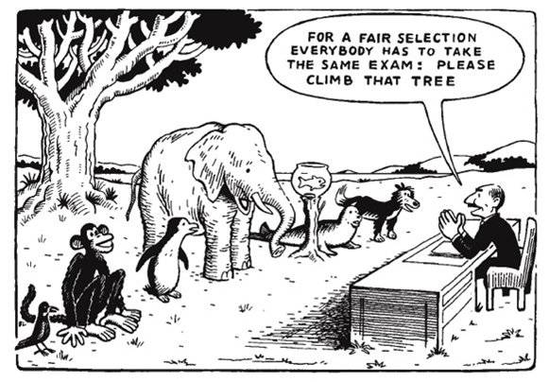
Notes:
Use this cartoon to recap the idea of validity and fairness when moderating an assessment item – follow with bullseye activity if found

Slide 22
In summary …
Moderation is:
… a process to make sure that assessments are valid, reliable, transparent, sufficient, fair, and authentic
… a critical component of quality assurance to make sure assessors' judgements are fair and consistent
… international best practice!

Slide 23
Session outcomes revisited:
Described the process of moderation.
Discussed the importance of moderation.
Applied best practice moderation principles.

Slide 24
Karakia Whakamutanga
Unuhia, unuhia
Unuhia ki te uru tapu nui
Kia wātea, kia māmā, te ngākau, te tinana
Te wairua i te ara takatā
Koia rā e Rongo, whakairia ake ki runga
Kia tina! TINA! Hui e! TĀIKI E!
Draw on, draw on,
Draw on the supreme sacredness
To clear, to free the heart, the body and the spirit of mankind
Rongo, suspended high above us (“heaven”)
Draw together! Affirm!

