Slide 1
Module Two
Session Eleven
Evaluative tools

Slide 2
Karakia Timatanga
Whakataka te hau ki te uru.
Whakataka te hau ki te tonga.
Kia mākinakina ki uta.
Kia mātaratara ki tai.
E hī ake ana te atakura.
He tio, he huka, he hau hū.
Tihei mauriora!
Cease the winds from the west.
Cease the winds from the south.
Let the breeze blow over the land.
Let the breeze blow over the ocean.
Let the red-tipped dawn come with a sharpened air.
A touch of frost, a promise of glorious day.

Slide 3

Waiata
Tō tatou waka
Ko te rangimārie
Ngā hoe o runga
Ko te puna o te aroha
Ko te puna o te aroha
Our vehicle of
peace paddles upon
the wellspring of love
the wellspring of love

Slide 4

Day plan
What’s happening today?

Slide 5

Session outcomes
Differentiate between evaluation …reflection …assessment.
Identified one form of evaluation that will be useful in their context.
Reviewed the role of evaluation in continuous quality improvement within their organisation.

Slide 6
EVALUATION
Difference between
Evaluation
Assessment
Reflection
Do you think they provide the same information?
Notes:
Evaluation has a variety of meanings:
Evaluating whether learning has happened – student/learner
Evaluating the lesson – tutor
"Evaluation" is sometimes used as a synonym for assessment. However, "evaluation" implies an estimate of overall value whereas "assessment" implies a specific measure. Educators must perform both processes. An "assessment" is an individually measured item whereas an "evaluation" is an estimate of the overall merit of the collection of assessed items. Ref: http://www.asyluminc.com/mb_manual/MK-int3.htm

Slide 7
Techniques for evaluating learning during and after a session:
Critical Incident Questionnaire (CIQ)
Paper shower
The Muddiest Point
One Sentence Summaries
One Minute Paper
Ticket Out of Class
Notes:
Critical incidents are vivid happenings that, for some reason people remember as being significant (Trip, 1993; Woods, 1993).

Slide 8
Feedback from students
Methods

Slide 9
Keep, Delete, Add, Alter
If we ran the course again exactly the same, what would you ....
Keep | Alter
Delete | Add

Slide 10


Closing round
Something that I think I understand well is ….
Something I am not sure about, or would like more explanation about, is ….

Slide 11
Ticket Out Of Class
Please spend the last five minutes responding to these two questions:
What was the main idea of today’s lecture/lab?
_________________________________________________________________________________________________________________________________________________________________________________________________________________________________________________________________________________________________________________________________________________________________________________
What questions do you have still outstanding?
_________________________________________________________________________________________________________________________________________________________________________________________________________________________________________________________________________________________________________________________________________________________________________________
Thank You

Slide 12
“One Minute Paper”
What concepts did you find interesting and easy to understand?
What concepts did you find unclear or puzzling and why?
What were the most important concepts covered in today's class and why?

Slide 13
The Classroom Critical Incident Questionnaire (example)
Please take about five minutes to respond to each of the questions below about this week's class(es).
At what moment in class this week did you feel most engaged with what was happening ?
At what moment in class this week did you feel most distanced from what was happening?
What action that anyone (teacher or student) took in class this week did you find most affirming or helpful ?
What action that anyone (teacher or student) took in class this week did you find most puzzling or confusing ?
What about the class this week surprised you the most ? (This could be something about your own reactions to what went on, or something that someone did, or anything else that occurs to you).

Slide 14

“Your teaching would be better if …… “
Something
“I enjoy your teaching when … “
Something
“Your teaching made me think about …..”

Slide 15
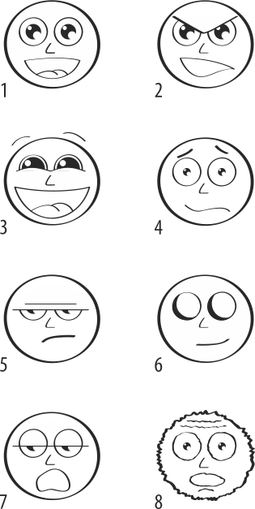
Feelings Based Warm-up/Evaluation
© 2012, Luke McConnell. FOR USE BY WINTEC ONLY.

Slide 16
Assessment
Specific instrument of measure eg a test.
Process of designing those instruments to gather data of a learner’s progress.
Notes:
The first refers to a specific instrument of measure. Any test is an assessment. The second refers to the process of designing measurement instruments and then using them to gather critical appraisal data about each learner's progress
Ref: http://www.asyluminc.com/mb_manual/MK-int3.htm

Slide 17
Reflection
Review of session | What went well? | What did not work at all? | What will I change?
Notes:
Refer to your resource book for self-evaluation of teaching …..

Slide 18
Summary
we evaluate projects or programs and assess student progress (e.g. give them tests).

Slide 19
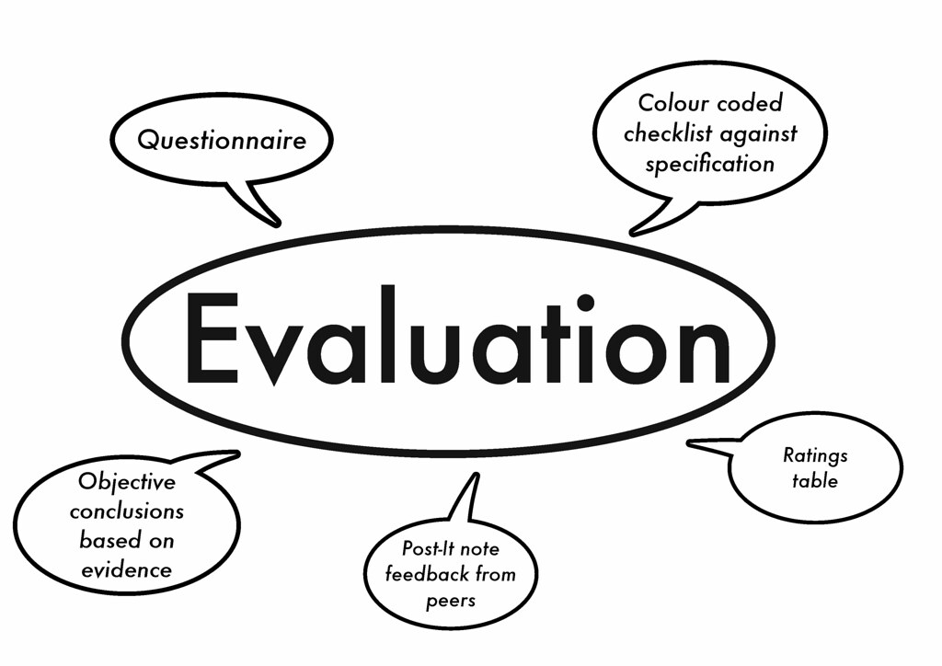
Programme Evaluation
Placing a value on the programme you offer.
Focus on the strengths and weaknesses of the programme.
To determine whether learning outcomes were met.
This Photo by Unknown Author is licensed under CC BY
Notes:
Does your organisation do this regularly? Have you ever been involved in this area? Develop the idea of continuous improvement – and part of the curriculum design process.

Slide 20
Some questions …
Why do we evaluate?
What do we evaluate?
Who evaluates?
How do we evaluate?
What do we do after we evaluate?

Slide 21
Why do we evaluate?
To identify and build upon existing strengths and good practice.
To identify areas for improvement.

Slide 22
What do we evaluate?
… our teaching
… our curriculum
… our resources
… our students’ satisfaction
In essence: the quality of the service we provide

Slide 23
Who evaluates?
…. we initiate the process
BUT
…. the students evaluate us!

Slide 24
How do we evaluate?
Student fora
Focus groups
Verbally (feedback)
Questionnaires
Surveys
Graduate destinations, etc
Notes:
There are a selection of evaluative forms in the resource book – eg: Tutor Self-Evaluation Checklist Tutor Self-Reflection Peer Review of Teaching using Observation- Example Lesson Observation Form [to be completed by a peer/colleague], Learner Evaluation - Example Learner Appraisal of Teaching Practice,

Slide 25
What do we do with the evaluations?
We gather
We analyse
We act
We feedback
We continuously improve

Slide 26

Review of Learning
In one sentence give one reason why you will evaluate your module/programme of study ….
In one sentence explain the difference between evaluation and assessment …..
Decide upon the one form of evaluation that will be useful in your context, and bring with you next session.
Notes:
NB: haven’t included “reviewed ed the role of evaluation in continuous quality improvement within their organisation” - that could be a takeaway activity – maybe forum on Moodle?

Slide 27
Karakia Whakamutanga
Unuhia, unuhia
Unuhia ki te uru tapu nui
Kia wātea, kia māmā, te ngākau, te tinana
Te wairua i te ara takatā
Koia rā e Rongo, whakairia ake ki runga
Kia tina! TINA! Hui e! TĀIKI E!
Draw on, draw on,
Draw on the supreme sacredness
To clear, to free the heart, the body and the spirit of mankind
Rongo, suspended high above us (“heaven”)
Draw together! Affirm!

