Slide 1
Day 6
NZ-Sino 6-Week
Model Programme
Train the Trainer

Slide 2

Warm-up
Whose turn is it today?

Slide 3

Overview of day 6
By the end of the session you will be able to:
Identify and describe deep and surface learning approaches
Compare active learning and passive learning strategies
Apply student centred instruction methods
Discuss student-centred teaching strategies
Identify and discuss the benefits and issues of active learning

Slide 4
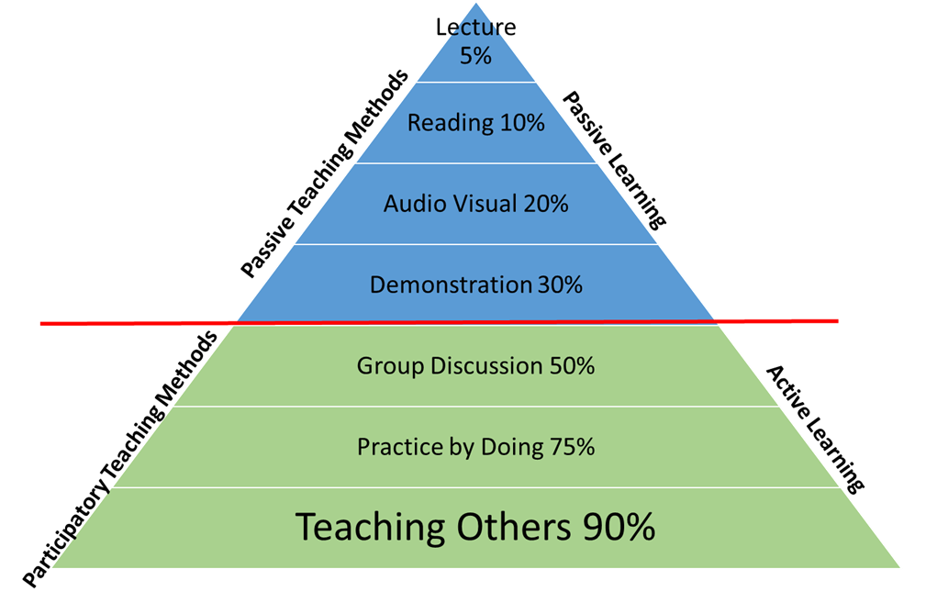
What does this suggest?

Slide 5


Deep Vs Surface
Deep learning refers to examining new facts and ideas critically, trying them out in existing cognitive structures and making numerous links between ideas. In contrast, surface learning is about accepting new facts and ideas uncritically and attempting to store them as isolated and unconnected items.
Adapted from Hattie & Donoghue (2016)
Notes:
https ://www.youtube.com/watch?v=6FS7NQpegMM

Slide 6
Characteristics of Deep and Surface Learning
Brainstorm ideas and create a poster presentation on characteristics of deep learning and surface learning.
Use the following prompts to create your presentation:
  What are the characteristics of deep learning and surface learning?
  What are the characteristics of learners adopting deep or surface learning strategies?
  How can you transform your existing instruction methods to impart deeper learning?
Present to the whole class

Slide 7
Teacher – Student?
Teacher-centred classroom | Learner/Student-centred classroom
The teacher is the focus Knowledge is transmitted to the learners from the teacher The learners’ role is passive The energy and activity sits with the teacher There is a risk of surface-learning | The teacher is the facilitator, providing support for the learners Knowledge is generated by the learners The learners’ role is active The energy and activity sits with the learners There is potential for deep learning The learners are the focus

Slide 8
Applying Student-centred Instruction Methods
Using laptops/smartphones, research the student-centred instruction methods assigned to you.
Choose a topic that you usually teach using a traditional instruction approach.
Discuss how you will teach the same topic using the student-centred instruction methods assigned to you.
Share with the whole class.

Slide 9
Active learning
Students are involved in more than listening.
More emphasis is placed on developing students’ skills compared to transmitting information passively.
Students are involved in developing higher-order thinking (e.g. analysis, synthesis, evaluation) by engaging in structured tasks.
Students are engaged in individual or group activities (e.g. reading, brainstorming, discussing).
Provides students a chance of self-exploration by reflecting on attitudes and values.

Slide 10
Benefits of active learning
In groups,
Brainstorm ideas on benefits of active learning.
Create a poster answering the following questions:
  What skills might students acquire through active learning?
  What might the challenges be in implementing active learning within your sessions?
  Describe possible solutions to address those challenges?
Share and discuss with class.

Slide 11
Problems with active learning
Review and discuss the problem assigned to you and write responses on the flip charts.
Visit the other corners of the room to review the other problems. Read the comments and using post-it notes, add your comments in relation to those problems.
Share with class and discuss how you will use active learning strategies in your teaching sessions.

Slide 12

Review of Day 4
What did you like about today?
What could have been done better?
What questions do you still have?
REMINDER: Who is doing the warm-up for tomorrow?

Slide 13
Day 7
NZ-Sino 6-Week
Model Programme
Train the Trainer

Slide 14
Warm-up
Whose turn is it today?

Slide 15
Overview of day 7
By the end of the session, you will be able to:
Identify the pros and cons of working with large groups
Discuss ideas for effective small group facilitation
Create a group expectation agreement
Brainstorm strategies for dealing with problem group members
Identify strategies for effective team and group work
Research and present of models of teamwork

Slide 16
Working with large groups
Large group teaching has traditionally been linked with lecture style teaching. Lectures were thought to be an efficient way of teaching to a large number. Recently however there has been a substantial shift away from lecturing towards a more student-centred style of teaching.

Slide 17
Pros and Cons
Brainstorm aspects of working with large groups and complete the middle column of Template E: Pros and Cons of Working with Large Groups.
Discuss and research each issue. Record positives and negatives and place in appropriate columns.
Then summarise your findings.
Share with the class.

Slide 18
5 tips – working with large groups
Match the WHERE with the WHO
Use more pair and group activities
Sample
Use individual or reflective work
Ensure safety

Slide 19
Working with small groups
Small groups are used to help solve problems, to explore the pros and cons of a solution, to bring out quieter members and to encourage people to share ideas. Small groups are one way to help meet task and individual needs in a group

Slide 20
Effective Small Group Work
Predict some best tips for ensuring effective small group facilitation. These are your main ideas. Write your responses in the first column of Template B
You now have 3 minutes to scan the following text ‘Tips for Effective Small Group Facilitation’ from Global Learning Partners.
You can now add to, and complete, Template B: What do you feel are the ‘Big Ideas’ for creating effective group facilitation?
Share your ideas with your neighbour.

Slide 21
Forming groups
When you are establishing working groups, it is important to remember two things:
Set out a clear set of guidelines for the group.
Have members formulate a common set of expectations.

Slide 22
Creating our own group expecatations
In small groups think of a group or team name then list the rules and expectations you agree to adopt for the duration of this programme.
Think about things such as:
  What you are willing to do in order to succeed
  What you expect from your tutor
  What you expect from their peers
  What the solutions or consequences will be if conflict arises
  Anything else?
Sign your agreed upon list of expectations and take photos of your agreement for future reference.

Slide 23
Strategies for dealing with problems group members
In your groups think about some of the difficult group members you have come across in your prior teaching.
What are some of the strategies you can use for dealing with problem students?
Complete Template C: Strategies for dealing with problem group members and include any other types of difficult students they can think of.
Share their ideas with another group.
Discuss as a whole class.

Slide 24
Ensuring effective team and group work
In groups discuss ideas for helping to deal with problem group members.
Using Template D: Ensuring Effective Team and Group Work think about what can be done to help with effective team and group work. When during the programme or task is the best time is to do it and what is the purpose of the suggested activity?
Share your ideas with a neighbouring group.
Then follow the QR Code in your SB and read some more from Oakely et al. (2004)
Discuss as a whole class

Slide 25
Group Needs
Task Needs
Individual Needs
Maintenance needs
The strength and the continued life of the group depend upon the degree to which these three types of need in the group are recognized and met. The effectiveness of the group will largely depend on the willingness of all members to share the responsibility for meeting these needs.

Slide 26
Tuckman’s Model
Forming
Storming
Norming
Performing
Adjourning

Slide 27
Stages of Tuckman’s Model
In your group:
Research the model you have been given using your computer or cell phone.
Create a visual presentation explaining your given model and to present it back to the class.
Can you see any similarities between the model you’ve been given and your own experiences?

Slide 28
Review of Day 7
What did you like about today?
What could have been done better?
What questions do you still have?
REMINDER: Who is doing the warm-up for tomorrow?

Slide 29
Day 8
NZ-Sino 6-Week
Model Programme
Train the Trainer

Slide 30
Warm-up
Whose turn is it today?

Slide 31
Overview of day 8
By the end of the session, you will be able to:
Identify a range of motivation and strategies for fostering motivation
Debate importance of stages of ARCS Model
Identify guidelines and applications for increasing learner motivation
Identify strategies for fostering student morale
Discuss a range of learning styles
Reflect on your own learning style and strategies for using this knowledge in your classroom

Slide 32
a teacher’s role in motivation
One of the roles of the teacher is to be motivated themselves.
Motivated teachers look at teaching through a different lens, and, in doing so, motivate their students in their learning too.
Motivation helps to energise, direct and sustain positive behaviour over a long period of time.
Do you think you are responsible for your learners’ motivation?

Slide 33
Intrinsic motivation comes from inside the learner; they want to do the activity for their own reasons.
Extrinsic motivation comes from outside them, they do it to please someone else or because they are told they need to do it.

Slide 34
Types of Motivation
In pairs:
Complete the table in Template A: Types of motivation
Add any examples from your own experience.
Discuss as a whole class

Slide 35
ARCS Model
Attention
Engage -use humour
Relevance
Immediate applicability
Confidence
Guidance
Activate
Use real stories, branding and challenges
Future usefulness
Experience
Identify clear benefits, relate to work situation
Self-confidence
Feedback
Contextualise assessment exercise and scenarios
Satisfaction
Reinforce
Positive outcomes
Unexpected rewards
Track completion of learning and praise performance
Variability

Slide 36
Which is more important?
In your group:
You have 15 minutes to research and brainstorm ideas to support the argument you have been given.
Make sure that you have watched the clip on the QRCode
Choose three team members to debate your side of the argument.
Following the debate you will need to decide which team has won and why their arguments were the most convincing.

Slide 37
Motivating students
Engagement and motivation are two of the most important aspects of teaching and learning. Motivation lies in the wanting or needing to learn a new skill or information. Understandably motivation will vary from person to person within your class. As a teacher, there are some ways we can impact our learners’ motivation.
Have a quick look at Pappas’ 17 motivational tips.
Which of these do you use? Which would you never use?

Slide 38
Guidelines for increasing learner motivation
Working in pairs match the applications from the box below Template B:
Compare your answers with another group
Discuss as a class.
  Do you agree with all of these points?

Slide 39
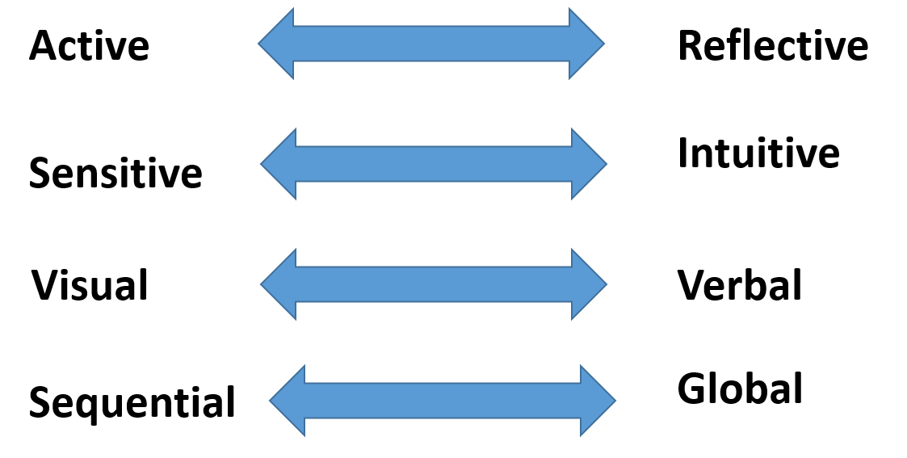
Learning styles

Slide 40
Four dimensions
Read through the Four Dimensions excerpt in your workbook
Decide which of each best reflects you.
Compare with the people near you.
Discuss as a class

Slide 41
VARK
Visual
Aural
Read/Write
Diagrams
Graphs
Colours
Charts
Written text
Different fonts
Spatial Arrangement
Design
Debates
Discussion
COnversation
Audio tapes
Video and audio
Seminars
Music
Drama
Books, Texts
Haundouts
Reading
Written feedback
Note taking
Essays
Multichoice
Bibliographies
Kinesthetic
Real-life examples
examples
Guest lecturers
Demonstrations
Physical activity
Constructing
Role plan
Working models

Slide 42
VARK Learning styles
Complete your own VARK Questionnaire following the QR Code below.
Once completed come forward and write your VARK scores and preferences on the whiteboard.
Discuss the differences
Read the Important Considerations In your SB and discuss as a class.

Slide 43
Using Learning Styles
Identifying your students as visual, auditory, reading/writing or kinaesthetic learners, and aligning your overall curriculum with these learning styles, will prove to be beneficial for your entire classroom.
Allowing students to access information in terms they are comfortable with will increase their academic confidence.

Slide 44
Using learning styles in the classroom
In groups of three or four and plan an activity, or a series of activities, for your class which will appeal to all VARK learning styles.
Use Template I: Using Learning Styles to record your responses. They should consider the following whilst planning:
Share with class.

Slide 45
Review of Day 8
What did you like about today?
What could have been done better?
What questions do you still have?
REMINDER: Who is doing the warm-up for tomorrow?

