Slide 1
Day11
NZ-Sino 6-Week
Model Programme
Train the Trainer

Slide 2

Warm-up
Whose turn is it today?

Slide 3

Day plan
Identify examples of inquiry-based learning
Create Inquiry-based learning questions
Reflect on the role of a teacher in inquiry-based learning
Research and identify the steps of problem-based learning
Plan a problem-based project
Discuss the benefits and challenges of flipped classrooms
Plan a flipped learning session
Any outstanding questions?

Slide 4
Inquiry based learning (IBL)
Inquiry-based learning (IBL) is a teaching method that engages learners in knowledge-building process through generation of open-ended answerable questions, ideas and analyses. Inquiry-based learning can occur with the context of short-term engagement (a single session), or longer-term assignment (e.g., over a semester).

Slide 5
Inquiry based learning
In groups,
Respond to the three questions provided in Template A: Inquiry-Based Learning. Each group must use a unique coloured pen to write their responses.
Exchange your templates with another group, who will add ideas in a different colour.
Keep exchanging and keep adding ideas to the templates until you receive your original template back.

Slide 6

How to get started
Questions, whether self-initiated or posed by others, are at the heart of learning by inquiry.
There are five different types of question that can be created to begin an Inquiry-Based Learning process. These are:
Factual
Convergent
Divergent
Evaluative
Combination

Slide 7
Creating questions for IBL
Consider a topic you teach, or will be teaching, and think about some inquiry questions that could begin a short inquiry process (for one activity, or one teaching session, or one week).
You must consider the level of understanding you want your learners to acquire by the end of the session.
Using Template B: Questions for inquiry-based learning, create five different type of questions (the questions might all relate to the same topic but provoke different level of thinking and learning).
Share with the class

Slide 8
Teacher’s role in IBL
The teacher’s role is critical in inquiry-based learning, but the role is different from that for which most teachers have been prepared. The teacher becomes the leader of the learning, or the facilitator of the learning process.

Slide 9
Role of a teacher in IBL
Reflect on how you prepare yourself to transition from being a teacher to be a facilitator.
Using the large sheet of papers, create posters on the pointers found in your workbooks.
Share ideas with class.

Slide 10
Problem based learning (PBL)
Problem-based learning is a student-centred learning approach where students work in small groups on a real-world problem or scenario, facilitated by a tutor, with little or no pre-determined answers. The fundamental principle of problem-based learning is the need for students to identify their own learning needs and subject knowledge that they think is important when addressing a problem-based scenario

Slide 11
Identify the problem
Describe the eproblem or phenomenon to investigate
Small group discussion
Activation of prior knowledge
Self-directed study
Investigating using variety of learning resources
Exchange of Information
Define the problem
What do we still need to know about the problem? (Learning outcomes)
Skills to use these resources
Integration of knowledge from different disciplines
Finding solutions
Sharing of ideas
digital literacies
Evaluating the information - whether acquired a better understanding of the process involved in the problem
Peer learning
Frame the
What is already known about the problem?

Slide 12
Problem based learning
In Pairs,
Brainstorm some characteristics of problem-based learning.
Write these ideas in the first column of Template C: Problem-Based Learning, labelled as “Characteristics of PBL”.
Do some research on the internet and enter your details, explanations, or examples for each characteristic in the second column of the template to articulate your understanding on Problem-based learning.
Share with class

Slide 13
Planning PBL
In pairs,
Think of a real-world problem you would like your students to investigate.
Using Template D: Planning PBL, plan a problem-based learning project for your students.
Share with class.

Slide 14
Flipped classrooms
Flipped learning is a pedagogical approach in which the conventional notion of classroom-based learning is inverted, so that students are introduced to the learning material before class, with classroom time then being used to deepen understanding through discussion with peers and problem-solving activities facilitated by teachers.

Slide 15
Flipping your classroom
Stage 1
Outside the classroom
Familiarise with basic content
Stage 2
In the classroom
Exploration of content
Stage 3
Further independent work

Slide 16
Benefits and challenges of flipped learning
In groups, do the following tasks:
  Group 1 to discuss potential issues, strategies to overcome issues, and benefits related to Stage 1 of flipped learning.
  Group 2 to discuss potential issues, strategies to overcome issues, and benefits related to Stage 2 of flipped learning.
  Group 3 to discuss potential issues, strategies to overcome issues, and benefits related to Stage 3 of flipped learning.
Fill in your responses in Template E: Benefits and Challenges of Flipped Learning.
Present and discuss ideas with the class.

Slide 17
Planning a flipped lesson
In groups, plan a lesson using flipped learning pedagogy on any topic of interest.
Use Template F: Flipped Learning to record your responses.
Consider the points listed in your workbook
Share with class

Slide 18

Review of Day 11
What did you like about today?
What could have been done better?
What questions do you still have?

Slide 19
Day 12
NZ-Sino 6-Week
Model Programme
Train the Trainer

Slide 20
Recap from Day 11
Do you have any questions from Day 11?
To answer your questions from the end of the day…

Slide 21
Warm-up
Whose turn is it today?

Slide 22

Overview of day 12
Identify the purpose of learning outcomes and their benefits.
Identify and write clear, SMART learning outcomes
Apply Bloom’s taxonomy to phases of learning
Plan using Bloom’s taxonomy

Slide 23
Goal tendering activity
Decide on team name and the number of times you think the ball will be successfully bounce into the container/box by the EACH team member.
Record on post-it note.
Have your ONE practice shot.
Complete the competition with each person having THREE bounces into the container/box.
Compare your predictions.
  How well did you do in accomplishing your goal?
  How did you determine the gaol?

Slide 24
Group activity
Decide on team name and the number of times you think the ball will be successfully bounce into the container/box by the EACH team member.
Record on post-it note.
Have your ONE practice shot.
Complete the competition with each person having THREE bounces into the container/box.
Compare your predictions.
  How well did you do in accomplishing your goal?
  How did you determine the gaol?

Slide 25
Group activity
In the group you completed the tennis ball game brainstorm the following two questions:
What is a Learning Outcome?
Why are Learning Outcomes important?
When you have completed join another small group and discuss what you have written. Jointly come up with a statement that has a minimum of 2 points on ‘What is a learning outcome’ and 4 points on ‘Why are Learning Outcomes important’.
Share this with the wider group.

Slide 26
Writing Learning Outcomes
Learning Outcomes are direct statements that describe the essential and enduring disciplinary knowledge and abilities that students should possess, and the depth of learning that is expected upon completion of a program or course. They focus on transferable knowledge, skills and behaviours that can be observed and assessed, and are reflective of disciplinary contexts.

Slide 27
Benefits of writing learning outcomes
In your pairs, discuss the benefits of writing learning outcomes
Write one benefit per post-it note and stick these on the flip chart on the board.
Share your responses with the whole class.
Note down the discussed benefits on Template A: Benefits of Learning Outcomes.

Slide 28
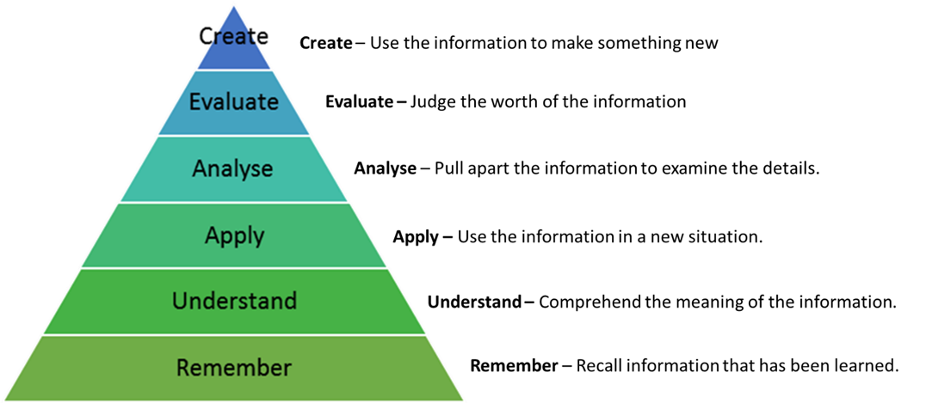
Cognitive Domain

Slide 29
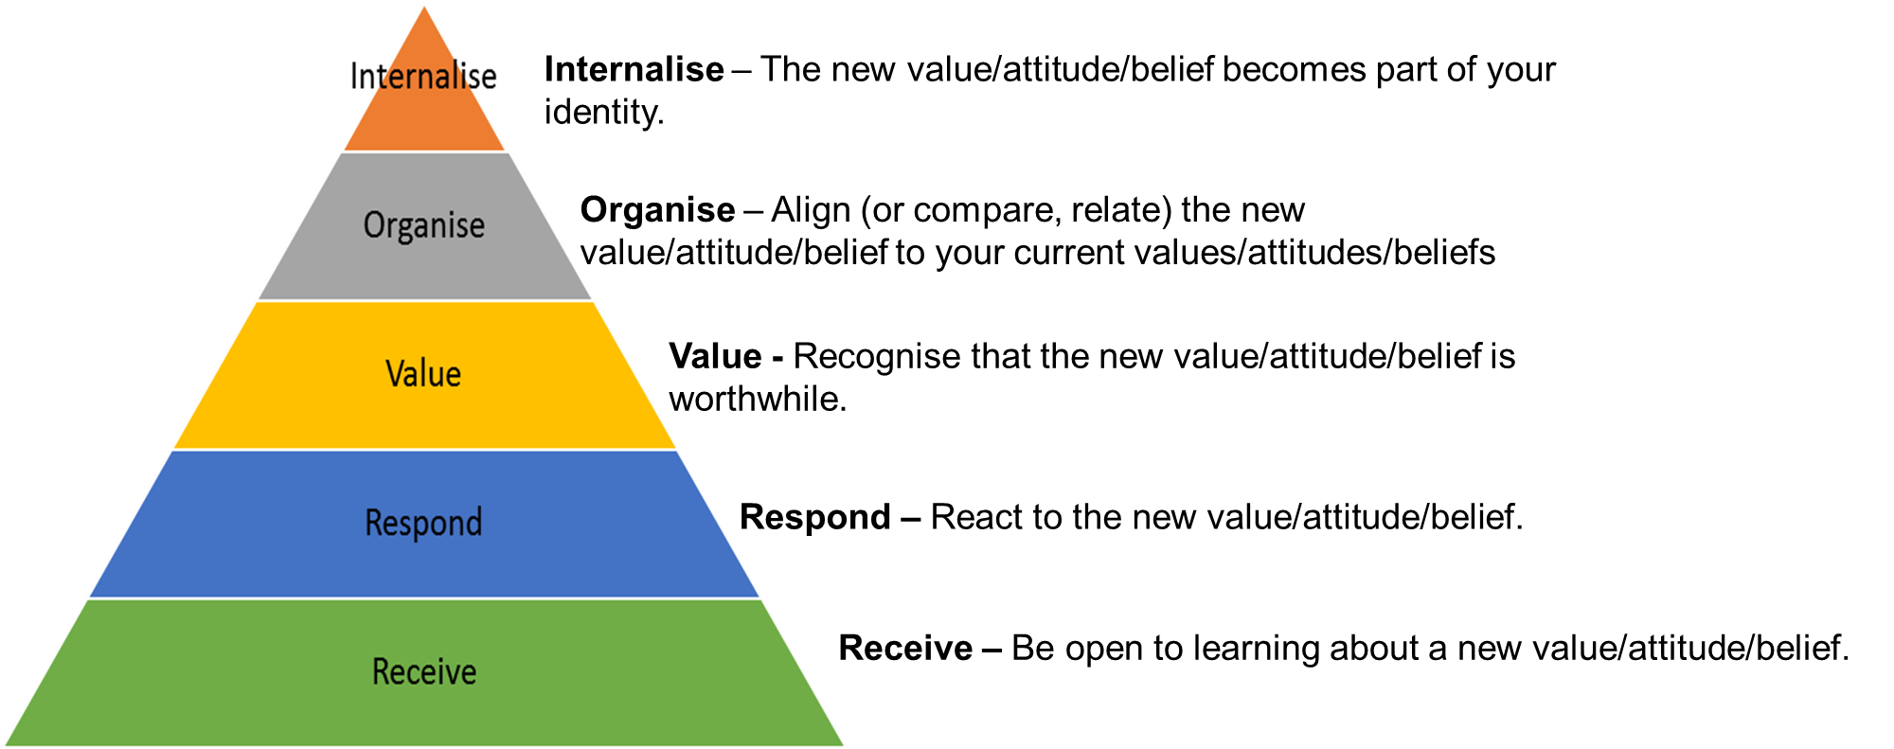
Affective Domain

Slide 30

Psychomotor Domain

Slide 31
Domains of learning
On your own identify the domains and levels of learning in the examples in Template B: Domains of learning.
You might like to check the examples on the following pages in your workbook.

Slide 32

SMART LOs

Slide 33
Identifying clear LOs
On your own:
Re-write the learning outcomes in Template C that you feel are not useful and improve them, remembering that they need to be SMART.
Compare your answers with your neighbour.
Discuss as a class

Slide 34
Whole class discussion
What are the most important things you want your students to accomplish?
What do you want them to remember or be able to do once they have completed your program?
What skills and knowledge will your students need after they graduate in order to be employable?
What will make them successful (in a job, in graduate school, in life, etc.)?
To what extent does your program (and/or its individual courses) provide opportunities for students to learn and practice these important outcomes?

Slide 35
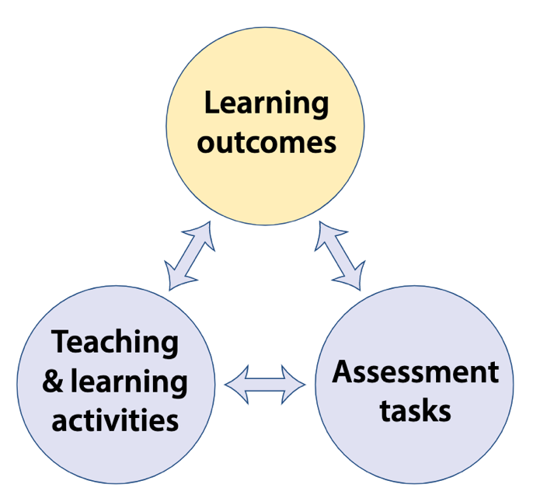
Constructive Alignment
The learning outcomes of a unit of learning should relate directly to the assessment task and assessment method in order to accurately check that the students have actually achieved the outcomes.

Slide 36
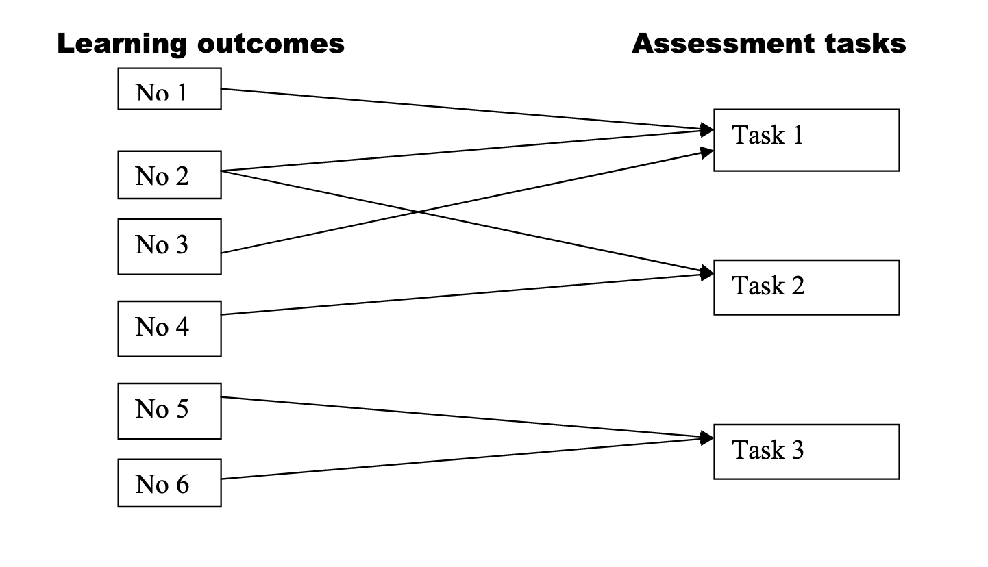
Mapping the links

Slide 37
How many Los do I need?
There are no hard and fast rules here, as it depends on factors such as:
The range of learning intentions – knowledge development? skills development? attitudinal/values change?
Length – whether a short course, semester, or full year
The particular discipline/course specific or generic graduate attributes you wish to develop.

Slide 38
Planning using Bloom’s
In groups:
Think of a particular course/unit/topic you teach
For each level of Bloom’s taxonomy (cognitive Domain), write example SMART objectives/learning outcomes, example activities and an example assessment for that course/unit/topic. Record your responses on Template D: Planning using Bloom’s Taxonomy
Once completed join with another group and critique their LOs and give feedback

Slide 39
Review of Day 12
What did you like about today?
What could have been done better?
What questions do you still have?
REMINDER: Who is doing the warm-up for tomorrow?

Slide 40
Day 13
NZ-Sino 6-Week
Model Programme
Train the Trainer

Slide 41
Recap from Day 12
Do you have any questions from Day 12?
To answer your questions from the end of the day…

Slide 42
Warm-up
Whose turn is it today?

Slide 43

Overview of day 13
Discuss the purpose of a lesson plan
Identify advantages and disadvantages of lesson planning
Order the six steps of lesson planning
Plan a student-centred practical workshop
Highlight the stages that occur in lesson plans before, during and after class
Sequence a series of activities

Slide 44
Advantages of Lesson planning
In pairs:
Discuss the purpose of a lesson plan.
Write your comments on the post-it notes and place on the whiteboard or flip chart
Discuss the comments with the whole class.

Slide 45
Advantages of Lesson planning
In groups:
In your groups share your past experiences of lesson planning.
  Do you plan all your lessons?
  What exactly do you do when planning a lesson?
Brainstorm what you think the advantages and disadvantages of lesson planning are.
Share a s a whole group.

Slide 46
Where do lesson plans come from?
Graduate profile
Course outline
Learning outcomes
Lesson plans

Slide 47
Steps for preparing a lesson plan
Establish LOs
Decide on content/sequence
Decide on methods
Evaluate
Reflection

Slide 48
Six steps for lesson planning
In groups:
Discuss each step and decide upon the best sequence of stages for lesson planning

Slide 49
Six steps for planning
Define end point
Identify authentic experience
Plan
Prepare
Facilitate
Evaluate

Slide 50
Planning practical lessons
In pairs:
Brainstorm ideas to plan a student-centred practical workshop session a topic of your choice.
Complete initial planning using Template A: Planning Practical Lessons.
After planning, create an instruction plan with appropriate details for your learners to follow during the practical workshop.
Share with the whole class. Discuss each plan’s strengths and limitations and ways to further improve the plans.

Slide 51
Before During and after
In pairs:
Brainstorm your thoughts on lesson planning based on your previous experience. Consider the following:
  What happens before, during and after class with their lesson plans?
  When do they alter or change their lesson plans?
  How do they share their lesson plans with their students
  What input do students have on their lesson plans? Do they think students should have any input into their planning?
Share with the whole class.

Slide 52
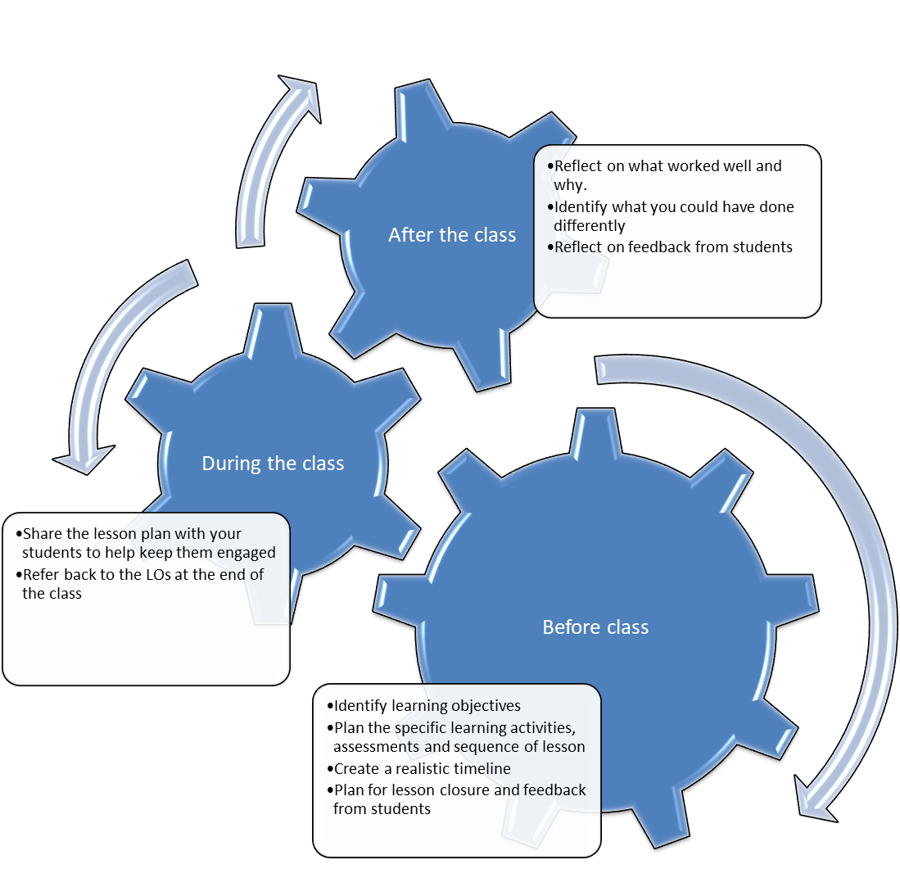

Slide 53
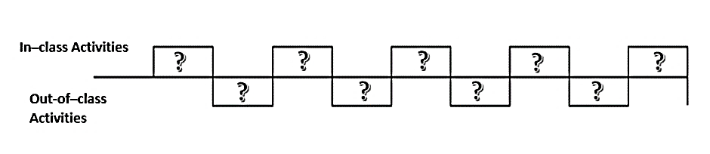
Sequencing lessons

Slide 54
Before During and after
In groups:
On a piece of large paper draw the Castle Top template and add the labels “In-class activities” and “Out-of-class activities”.
Using the Learning Outcomes from this Unit, design a sequence of learning activities for a 5 week (I day per week) course.
Facilitate groups moving around to look at other groups’

Slide 55
Review of Day 13
What did you like about today?
What could have been done better?
What questions do you still have?
REMINDER: Who is doing the warm-up for tomorrow?

