Slide 1
Day16
NZ-Sino 6-Week
Model Programme
Train the Trainer

Slide 2

Warm-up
Whose turn is it today?

Slide 3
Recap from last week
Do you have any questions from last week?

Slide 4

Day plan
Discuss principles of effective materials design.
Create a learning resource for a flipped classroom
Create appropriate teaching and learning resources and activities for student-centred learning.
Apply a range of 21st Century teaching tools to your teaching context
Brainstorm the benefits of social software teaching
Review a range of interactive technology tools

Slide 5
Developing learning resources
Learning resources or teacher materials is a generic term used to describe the resources teachers use to deliver instruction. These resources can support student learning and increase student success. Ideally, teaching and learning resources will be tailored according to the level of learners and the purpose of sessions.

Slide 6
Aligning materials
Resources
Curriculum
Student’s interests
Contemporary culture
Learning outcomes
Assessments
Teaching and learning activities

Slide 7
Learning resources
Drawing from your own experience, or using your research skills, create a list of context-specific teaching and learning resources that can be used to reinforce the content that you teach.
Remember to focus on resources that your students can interact directly with.
Use Template A: Teaching and Learning Resources to record your ideas.
Choose one idea to develop further. Outline how and when it could be implemented and what the benefits would be.
Join the class discussion to share ideas.

Slide 8
Creating learning resources
Prior to class you should have read the following sections:
  Tips for using teaching and learning resources
  Seven-Step Process to Design Learning Materials
  Adapting or Modifying Existing Materials
  Checklist for Designing Your Own Game
In your groups create a learning resource using the resources currently available in the classroom.
Once completed you will rotate around the classroom to hear each group present their resource.

Slide 9
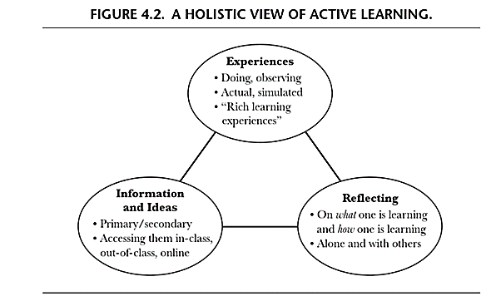
Rich Learning Experiences

Slide 10
Rich Learning Experiences
In your groups:
Read the information from Fink in the section Designing Curriculum Activities. Further information is available at the QR code in your book or research it yourself.
Your group needs to create detailed examples of Rich Learning Experiences for the context they work in.
Rotate around the room to read and critique the Rich Learning Experiences.
Join the discussion on what we have learned from this activity

Slide 11
How much practice?
Difficulty
Importance
Frequency

Slide 12
How much practice
In your groups:
Think about the industry your students will be working in. Write down three tasks that they may be required to carry out in the industry.
Using the table in your workbook, work out how much practice is recommended to learn each of the three tasks to an appropriate level.
Do you agree?
Choose on task and brainstorm how you would teaching it in order to provide a suitable amount of training

Slide 13

What is social software?
“Software that supports group interaction” (Shirky, 2003)
“Software that allows people to interact and collaborate online or that aggregates the actions of networked users” (Mejias, 2005)
“networked tools that support and encourage individuals to learn together while retaining individual control over their time, space, presence, activity, identity and relationship” (Mejias, 2005)

Slide 14
Benefits of social software
Read the information on Social Software, and the Examples of Social Software.
Working in groups of three, brainstorm the benefits of social software for teaching.
Which of the above examples do you think would be most useful in your teaching context? Why?
Share your ideas with the class.

Slide 15
Reviewing interactive technology
Choose one 21st Century Teaching tool for your pair (further tools available via QR code).
You are responsible for researching a different teaching tool and planning a short 5-10 minute session to enable the class to interact with and learn about the tool.
You will have some time in class to begin this, and some time out of class to complete your planning.
You should use the information and tips from this booklet to support your planning.

Slide 16

Review of Day 16
What did you like about today?
What could have been done better?
What questions do you still have?

Slide 17
Day 17
NZ-Sino 6-Week
Model Programme
Train the Trainer

Slide 18
Recap from Day 16
Do you have any questions from Day 16?
To answer your questions from the end of the day…

Slide 19
Warm-up
Whose turn is it today?

Slide 20

Overview of day 17
Discuss strategies to assess large and small groups in variety of contexts.
Apply assessment strategies to your own teaching context.
Create a rubric to assess a field-based activity
Review a range of assessment activities
Apply constructive alignment to assessments and activities

Slide 21
Assessment strategies for large classes
Using the Internet, research about large group assessment strategies as mentioned in Template A: Pros and Cons of large Group Assessment.
Discuss at least three pros and cons of each method and suggest ways to either improve the strategy or an alternate strategy to assess large groups.
Share with whole class.

Slide 22
Pros and cons of group assessment
Pros | Cons
Easiest to implement - does not require any additional work aside from marking the projects Appropriate if group work mark is a minor part of total mark for the course Group responsibilities are enforced - group succeeds or fails together | Individual contributions are not reflected in the distribution of marks Poor students may benefit from the work of hard-working students Good students may be dragged down by poor students Does not motivate students
(Centre for Teaching Excellence, University of Waterloo)

Slide 23
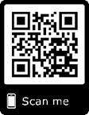
Assessing small groups
Individually:
Follow the QRCode and read the article
In groups:
Discuss the questions in your workbook.
Use Template B: Assessing Small Groups to fill in your responses.
Share with whole class.

Slide 24
Assessing field based activities
If field trips are approached with the same assessment-based mindset as with the classroom instruction, there is a better chance to implement and measure improvements in student learning outcomes. Moreover, applying the same assessment attitude towards the industry partner will also make the benefits of field trips more apparent to them (Cyr and Lucas, 2002)
Share your field trip experiences? How were they assessed?

Slide 25
Using Rubrics
Rubrics are a tool to make assessments easier and fairer for both students and the teachers.
Rubrics are usually handed out prior to the activity and focus on, not only the output, but the quality of the output as well that students are required to produce.
Students can set themselves a target to achieve the grade or quality of work they want to achieve.

Slide 26
Create a rubric
In groups,
Think of a field-based activity related to your area of interest.
Create a rubric to assess that activity.
Share with whole class and discuss how this rubric will be useful in conducting self-assessments of students.

Slide 27
Assessment for learning
Assessment for learning (formative assessment) occurs when teachers use assessments in order to adjust their teaching strategies and when students use assessments to adjust their learning strategies.
Assessment for Learning Approaches:
learning conversations and detailed questioning
observations
student self-assessments or peer assessments
more formal assessment tools, such as checklists or observation lists can also be used
Written feedback designed to inform and provide clarity for next steps

Slide 28
Formative and Summative
Formative assessment: | Summative assessment:
Definition: Formative assessment is more diagnostic than evaluative. Formative assessment is usually carried out throughout the learning process. It is primarily designed to encourage further learning and change (Fulcher & Davidson, 2007). | Definition: Summative assessment provides the benchmark to check progress of students and teaching. “Summative assessment is conducted at the end of a programme of study to assess whether and how far individuals or groups have been successful” (Fulcher & Davidson, 2007, p.376).
Is an integral part of the learning process Information is shared with the learner Information is available on quality of learning. Is linked to learning intentions and success criteria. Is focused on the next stages of learning | Happens after learning has taken place Information is gathered by teacher Information is usually transferred into marks Comparison with performance of others Looks back on past learning

Slide 29
Types of assessment
In your pairs,
Review the learning outcomes and assessment activities listed in Template C: Types of Assessment Activities.
Select activities that correspond to the intended learning outcomes.
Share with the class.

Slide 30
Pros and cons of types of assessment
In your pairs,
Discuss the pros and cons of assigned assessment activities.
Discuss how you can use these activities in your teaching practice.
Fill in your responses in Template D: Pros and Cons of Assessment Activities.
Share with the whole class.

Slide 31
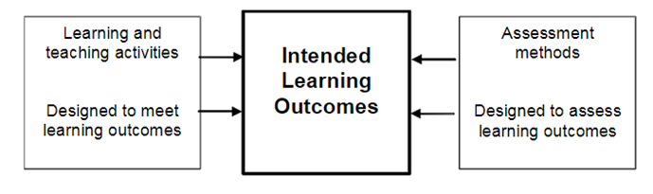
Constructive Alignment

Slide 32
Constructive Alignment
In Template E: Constructive Alignment are two intended learning outcomes.
Based on these outcomes, brainstorm ideas for Assessment Methods.
Choose one assessment method that you think will be effective and brainstorm Learning and Teaching Activities that could support learners prior to attempting the assessment.
Use the principles of constructive alignment to inform your choices.
Join the class discussion to share ideas.

Slide 33
Review of Day 17
What did you like about today?
What could have been done better?
What questions do you still have?
REMINDER: Who is doing the warm-up for tomorrow?

Slide 34
Day 18
NZ-Sino 6-Week
Model Programme
Train the Trainer

Slide 35
Recap from Day 17
Do you have any questions from Day 17?
To answer your questions from the end of the day…

Slide 36
Warm-up
Whose turn is it today?

Slide 37

Overview of day 18
Identify the process for assessment for learning
Revise uses of rubrics for formative use
Research good practices for feedback
Identify key points for feedback

Slide 38
Assessment for Learning
Central to the practice of assessment for learning (formative assessment) is the concept that students who truly understand and are involved in their learning will experience accelerated rates of achievement. Students who are involved in their learning can be thought of as assessment-capable or active learners. They know what they need to learn, where they are with that learning and what their next learning steps are.
TKI.org.nz

Slide 39
Assessment for learning – the process
Carefully read the given statements on the next page.
Put the statements in order using Template A: Assessment for Learning – the Process to describe the ideal process for Assessment for Learning.

Slide 40
Feedback for learning
What is Feedback?
Feedback is providing information to an individual which focuses on their performance or behaviour.
The feedback provided should be delivered in a positive manner and lead to action to affirm or develop an individual’s performance or behaviour.
Feedback provided should not be of a personal nature and should focus on hard data, facts or observed examples of evidence.

Slide 41
Characteristics of rubrics
Most rubrics are holistic in nature and assess the whole product rather than assessing different aspects of the product. Not all rubrics are suited to formative use. Three essential characteristics that make them fit for formative use are (Chappuis, 2015):
  Descriptive Quality
  Generalizability across tasks
  Analytic structure

Slide 42
Create a rubric for assessment
Review the rubrics you have been given and compare to the characteristics discussed in the preceding section.
Using Template B: Revising Rubrics for Formative Use, to note down any changes needed to make in the rubrics to ensure they function well as formative tools.
Implement the suggested changes and revise the rubrics.
Share and discuss with whole class

Slide 43
Types of feedback
Affirmative Feedback | Affirmation feedback is provided as soon as possible after a performance has been observed: “Well done, Ben, you observed safe working practices while installing bearings on the pump shaft.”
Developmental Feedback | Developmental feedback guides the student on steps to improve their performance: “Nancy, next time you stretch paper, use gum strip instead of masking tape to secure the paper to your drawing board.”
Effective Feedback | Effective feedback is tailored to meet the needs of the individual and is directly linked to observable evidence – either a learner’s written or practical work or a performance of a given task. It focuses on individual action points, dealing with one point at a time.
Adapted from Jones (2005)

Slide 44
Good practice for feedback
In groups:
Brainstorm and research good practices for giving feedback.
Present your ideas back to the class.

Slide 45
Nicol’s good practice
Prepare students for feedback
Tone down negative comments
Align feedback with assessment criteria
Give feedback in a timely manner
Be specific, relevant and manageable
Don’t praise for praise’s sake

Slide 46
Key points for feedback
In groups:
Create a visual resource (such as a poster, diagram, mind map, etc.) highlighting good practices for feedback.
Present to the whole class.
Give each other ‘fair and constructive’ feedback .

Slide 47
Do’s and don’ts
Discuss the dos and don’ts of verbal and written feedback (think about the verbal or written feedback that you have received as a student and during this course).
Write your responses in Template C: Dos and Don’ts of Feedback and share with the whole class.
.

Slide 48
Review of Day 18
What did you like about today?
What could have been done better?
What questions do you still have?
REMINDER: Who is doing the warm-up for Monday?

